Slide 1
California Senate Committee on Energy, Utilities and Communications Informational Hearing “Petroleum Windfall Profits Penalty: Will Californians get relief at the gas pump?”
David J. Hackett
Chairman
Stillwater Associates LLC
February 22, 2023
Notes:
Stillwater Associates is a transportation energy consulting company. Our clients include the California Energy Commission, the California Department of Justice, the US Department of Energy, the Energy Information Administration, the Environmental Protection Agency, as well as trade associations, and individual firms interested in the space.

Slide 2
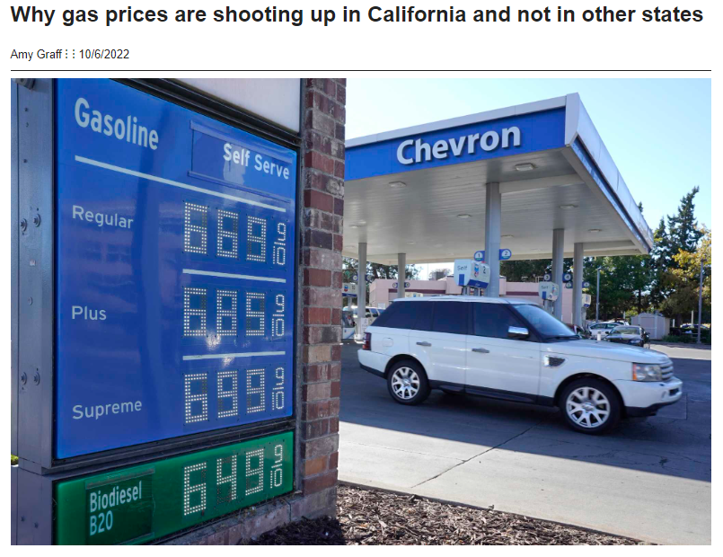
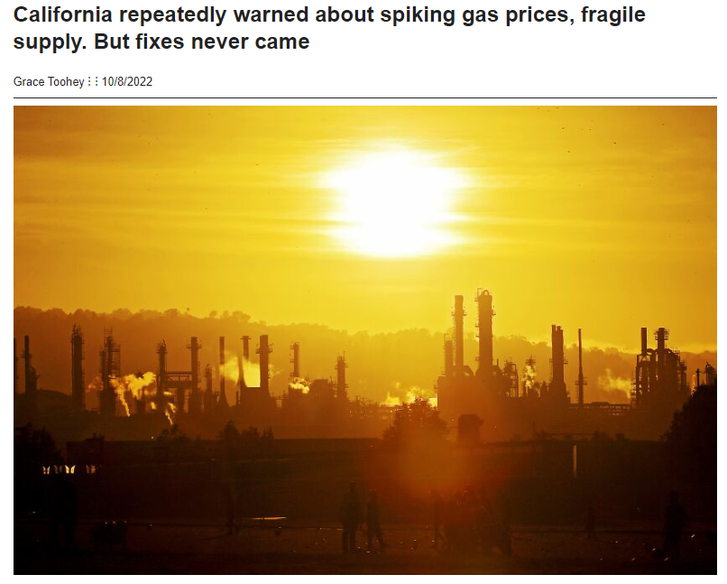
When California gasoline prices spike, everyone wants to know why
San Francisco Examiner
Los Angeles Times
Notes:
When gas prices have gotten too high, reporters call looking for an interview on the issue.

Slide 3
What to do about gasoline supply and price today and through the energy transition?
Notes:
The issues include;
Everyday high gas prices.
Price spikes due to refinery issues and geographic isolation.
And the historic rapid transition to a different form of transportation energy.

Slide 4
What are the Big Issues here?
Why are gas prices so high?
What should we be doing about that?
Are price controls like the Windfall Profits Penalty effective?

Slide 5
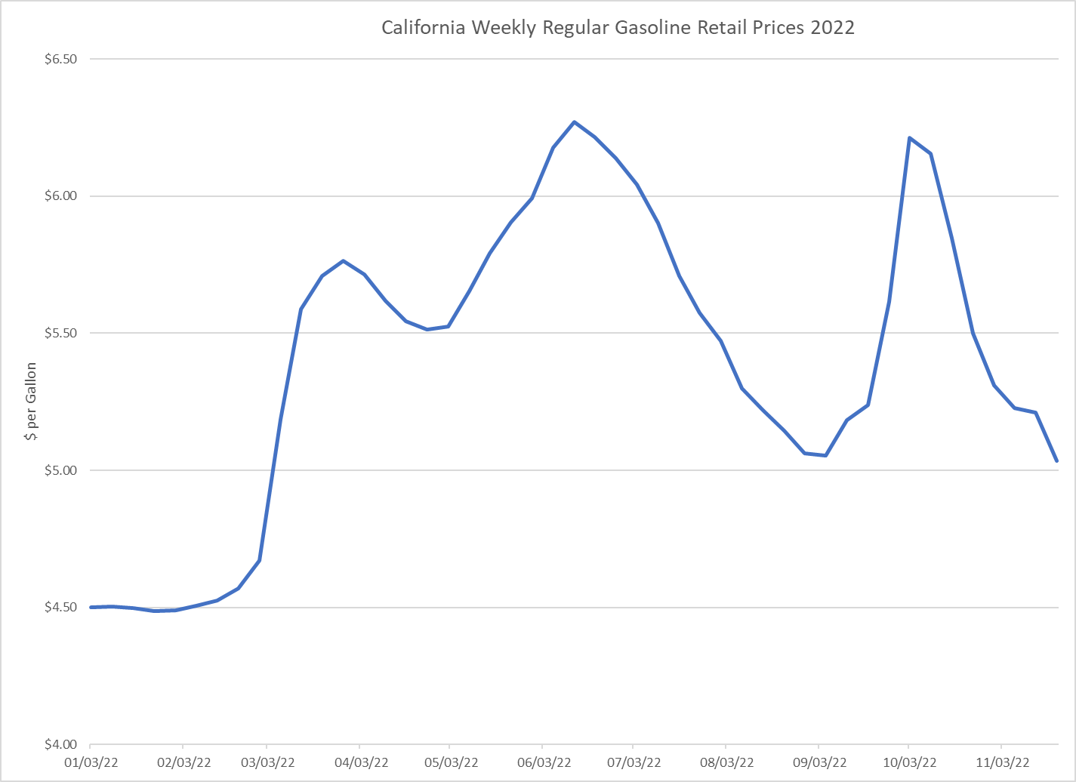
What caused high oil prices in California in 2022?
Covid & the Ukraine war, combined with refinery problems.
Source: EIA
Notes:
The high prices were caused by supply issues:
In 2020, Covid caused oil prices to crash as demand evaporated. Demand started to come back in 2021. Covid was largely responsible for the shutdown of a major refinery in the Bay Area.
The Russo/Ukrainian war began in March 2022 and upset worldwide trade patterns, causing many commodity prices, including oil, to rise dramatically.
California refinery gasoline production in ‘22 was reduced by 88 kbd vs prior year. This is equivalent to a mid sized refinery’s output. We think this is generally a Covid hangover, but there are other factors as well.
For example, gasoline imports were lower than 2021, caused by a near tripling of freight rates.
This resulted in a strong inventory draw to decade record low inventory levels.
Consequently, spot prices rose as supply was tightened, pushing retail prices up in August and September.
We see this as a cautionary tale about depending on long distance imports for gasoline supply.

Slide 6
What are the recommendations to prevent spikes and reduce gasoline prices?
Supply Driven Price Spikes
Ongoing high retail prices
There are two basic issues.
Notes:
Recommendations include:
The Energy Commission needs to take a serious look at the impact of local and state regulations on the viability of the oil industry, as well as review the work the Commission did in the past in this area, especially including the work twenty years ago on the Strategic Fuel Reserve and related issues.
A component of the Mystery Gas Surcharge is the gross profit margin that can be defined as the difference between retail price and wholesale rack price. Stillwater’s analysis indicates that this is higher than the rest of the country because of a lack of competition. One factor in the lack of competition is that California has twice as many licensed drivers per station as the rest of the country.

Slide 7
What needs to be considered in the transition study?
What will it take to shift all the energy in the oil and gas pipelines to the wire?
We don’t think anyone really knows.
We can’t afford to get it wrong.
This is an historic shift from oil & gas to electricity
Notes:
Realistic assumptions on how fast transportation alternatives can come on-line are imperative. For example, according to Stillwater’s analysis of ARB data, the real success story of the LCFS is renewable diesel which makes up about 39% of diesel energy, while Electric Vehicles only make up about 1% of the gasoline pool.
We are concerned that the fuels refineries will shutter before the transition is complete, leaving the market import dependent. We don’t want the state’s energy policy to export its strategic refining capacity to Asia Pacific or Europe.

Slide 8
What about the Windfall Profits Penalty?
There is a long record of failure of similar programs.
Notes:
Energy economist Tony Finizza lectured on the history of price controls.
Professor Finizza had 6 lessons:
Getting into controls is a lot easier than getting out of controls.
No matter how clever the price fixer or how big his staff or computer, distortions inevitably result.
Controls beget more controls. To correct imbalances, caused by price controls, more elaborate controls are needed to correct the distortions.
Quality decreases with controls. Suppliers substitute inferior products to beat the controls.
Price controls usually increase prices. While controls hold down prices artificially for a while, they soon start rising or soaring.
Voluntary controls usually give way to mandatory controls.

Slide 9
Thank you.
Questions?
Notes:
A transportation energy consulting firm focused on policy, technology development, mergers & acquisitions, and litigation support.
888-643-0197
www.stillwaterassociates.com

