Slide 1
California Gasoline Margins
Testimony Before the California Senate Committee on Energy, Utilities, and Communications
Robert McCullough
Principal
McCullough Research
February 22.2023

Slide 2
Bottom Line
Refiners set the prices at gas stations based on the spot market price.
The spot market price is set in an obscure market based on a limited number of trades – self-reported trades at that.
The calculation of the spot market price is neither transparent nor subject to any official review.
In 2022, this price was inexplicably high and cost Californians billions of dollars.
This is why California needs a limit on price gouging.

Slide 3
Background
West Coast California markets are dominated by trading at the Los Angeles terminus of the Kinder Morgan West pipeline.
The Oil Price Information Service (OPIS) reports the “Basis Differential” for the two California markets (L.A. and San Francisco) on a daily basis.
Contracts across the West Coast reference the OPIS indices.
As far as I know, no external agency subscribes to or performs market surveillance on this critical index.
Inexplicable changes in the index are common and have immediate impacts on wholesale and retail gasoline prices in California and other West Coast state
U.S. Senator Maria Cantwell has often remarked that we know more about the market for soybeans than the markets for oil and gasoline.

Slide 4
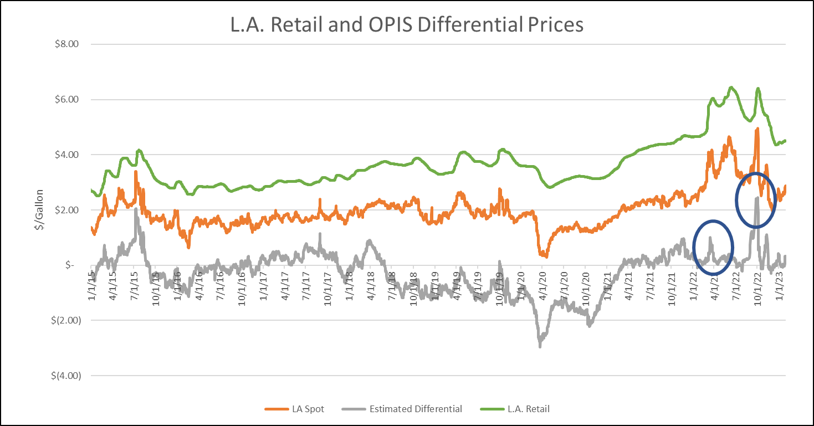
Whither 2022: Two Inexplicable Spikes

Slide 5
What Happened in 2022?
In March, OPIS reported an unchanged index on two sequential weeks – think of the uproar if this occurred at the DJI Industrial index. According to OPIS only one completed trade took place during this two week period.
In September and October, the OPIS index exploded even though OPIS itself had questioned the importance of refinery operations.
The OPIS index triggered staggering changes in retail gasoline prices.

Slide 6
Takeaways:
California consumers paid $4.7 billion more for CARBOB gasoline in 2022 than in 2021 – even after the costs are corrected for inflation. This is an inflation adjusted increase of 7.1%.
The wholesale markup – the difference between the price of oil and the prompt price at the pipeline in L.A. – increased by $10.0 billion. This was an increase of 30.6% in real terms.
The cost of crude oil added $55.6 billion to consumers bills in 2022. The crisis in Ukraine added less – both in absolute terms and in percentage terms than wholesalers’ margins in California. The percentage increase to the cost of crude oil was 25.5%.
The retail margin actually fell by $5.2 billion in 2022 – a decrease of 15.4%. The wholesale margin surged upwards by 46.8%.

Slide 7
We need both transparency and price stability
There is substantial evidence of market power and gaming in California gasoline markets.
Market surveillance exists for other fuels and markets.
Simply put, streetlights reduce crime.
Windfall profit caps and price gouging limits remove the incentive for market misbehavior and protect consumers.

