Slide 1
How CCAs are Enhancing Electricity Rate Affordability
March 2023

Slide 2
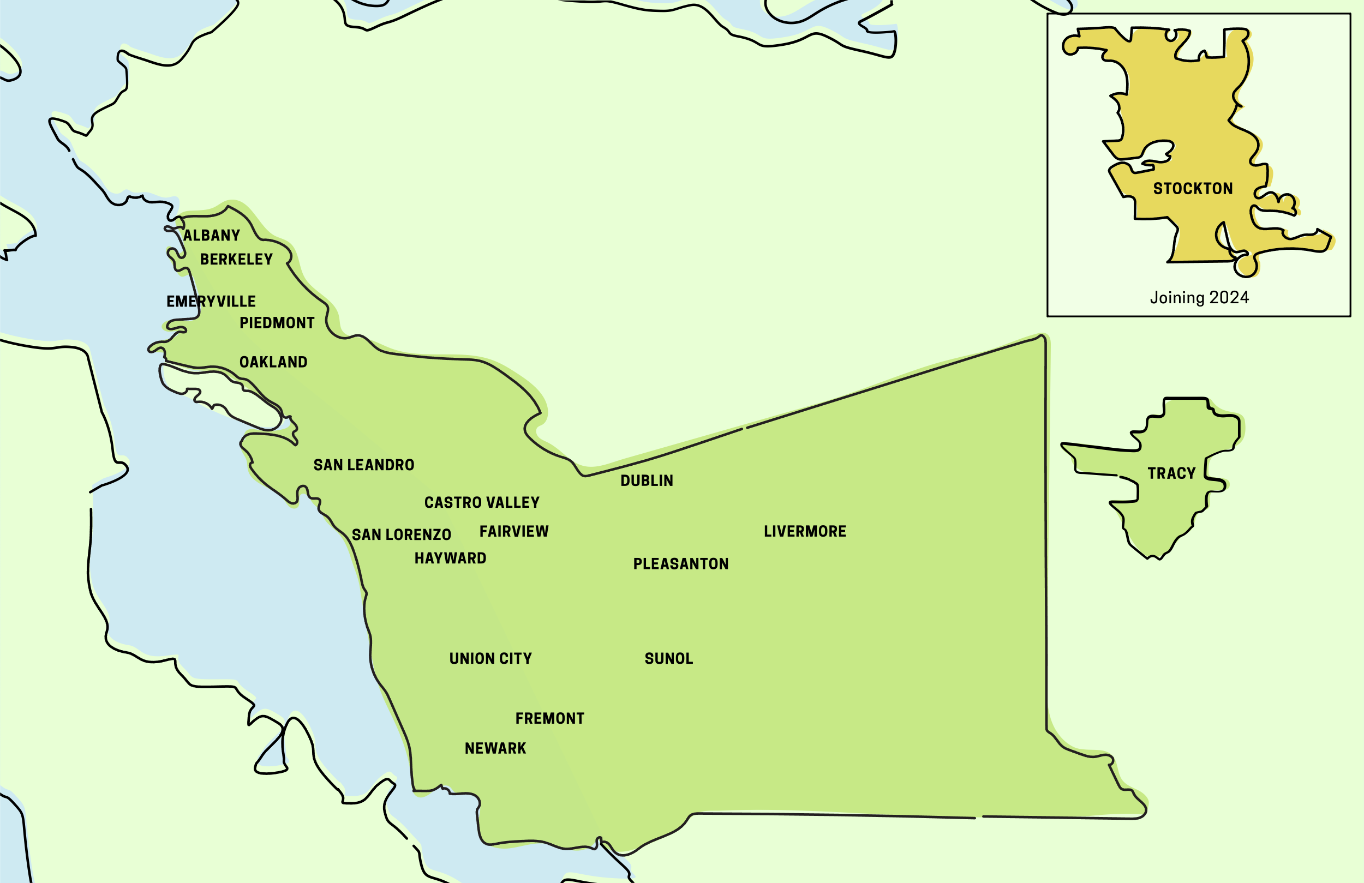
EBCE Member Jurisdictions
Alameda County and the City of Tracy are members of EBCE’s Joint Powers Authority (JPA). The City of Stockton joined the JPA in 2022 with EBCE's service to begin in 2024.
2

Slide 3
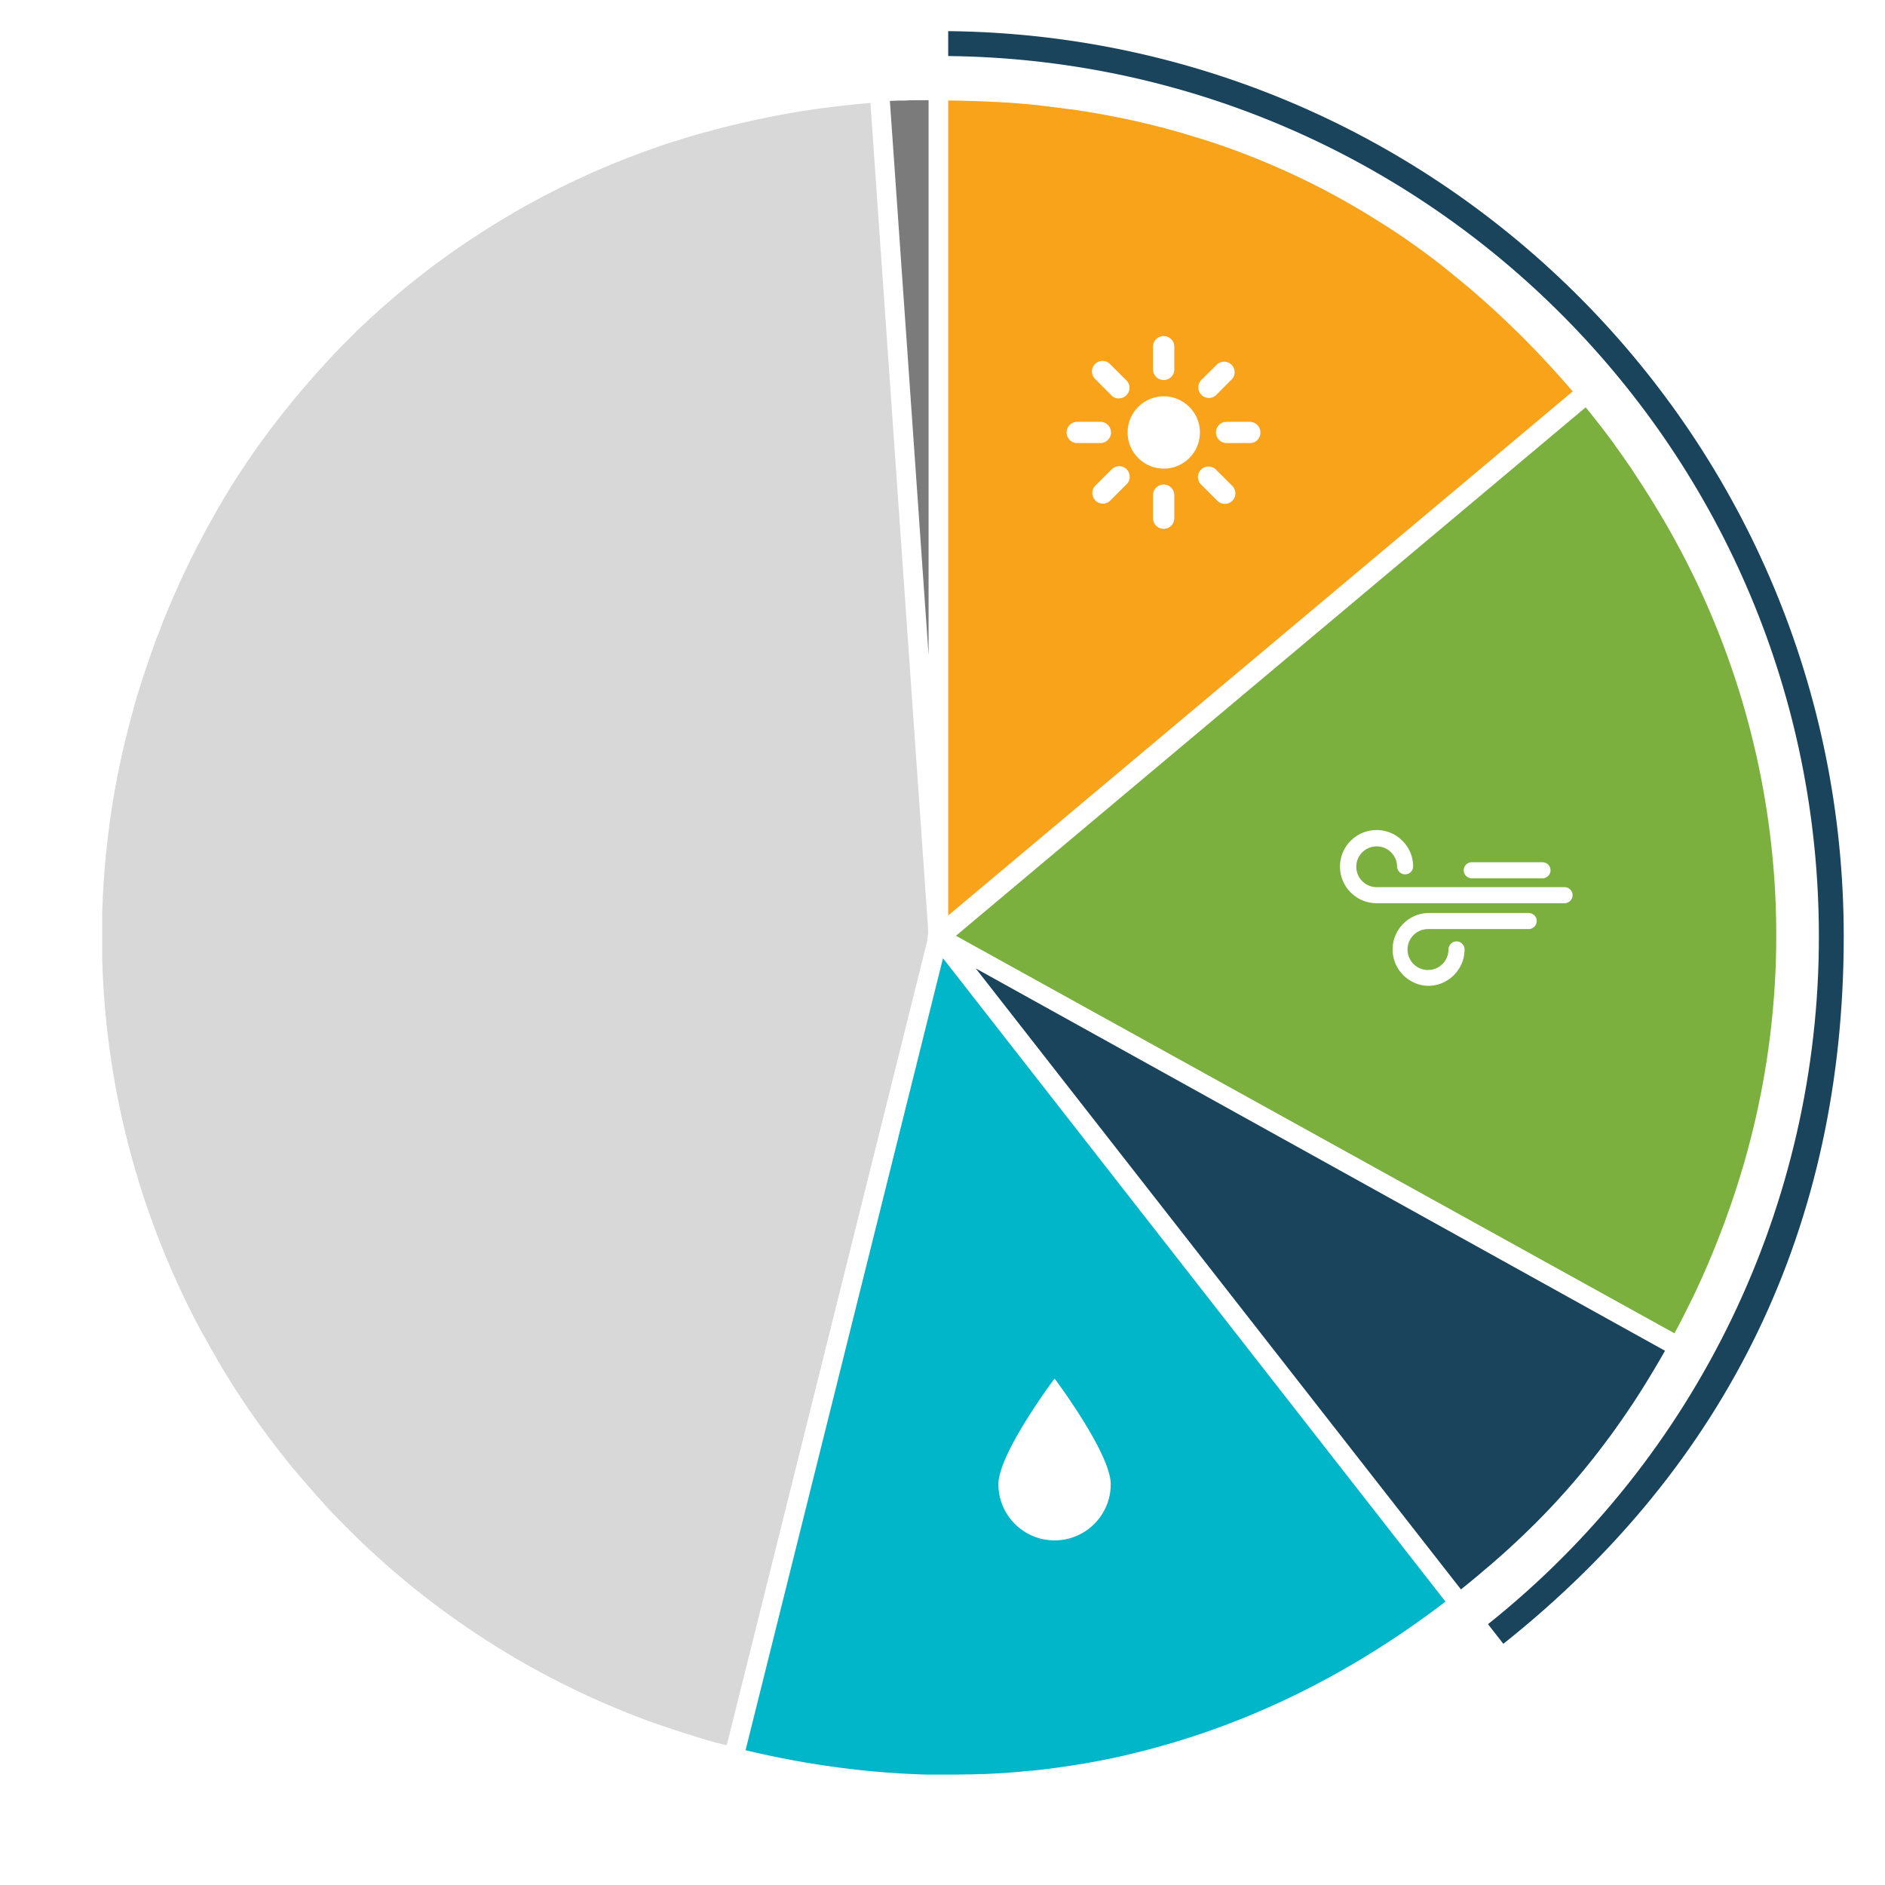
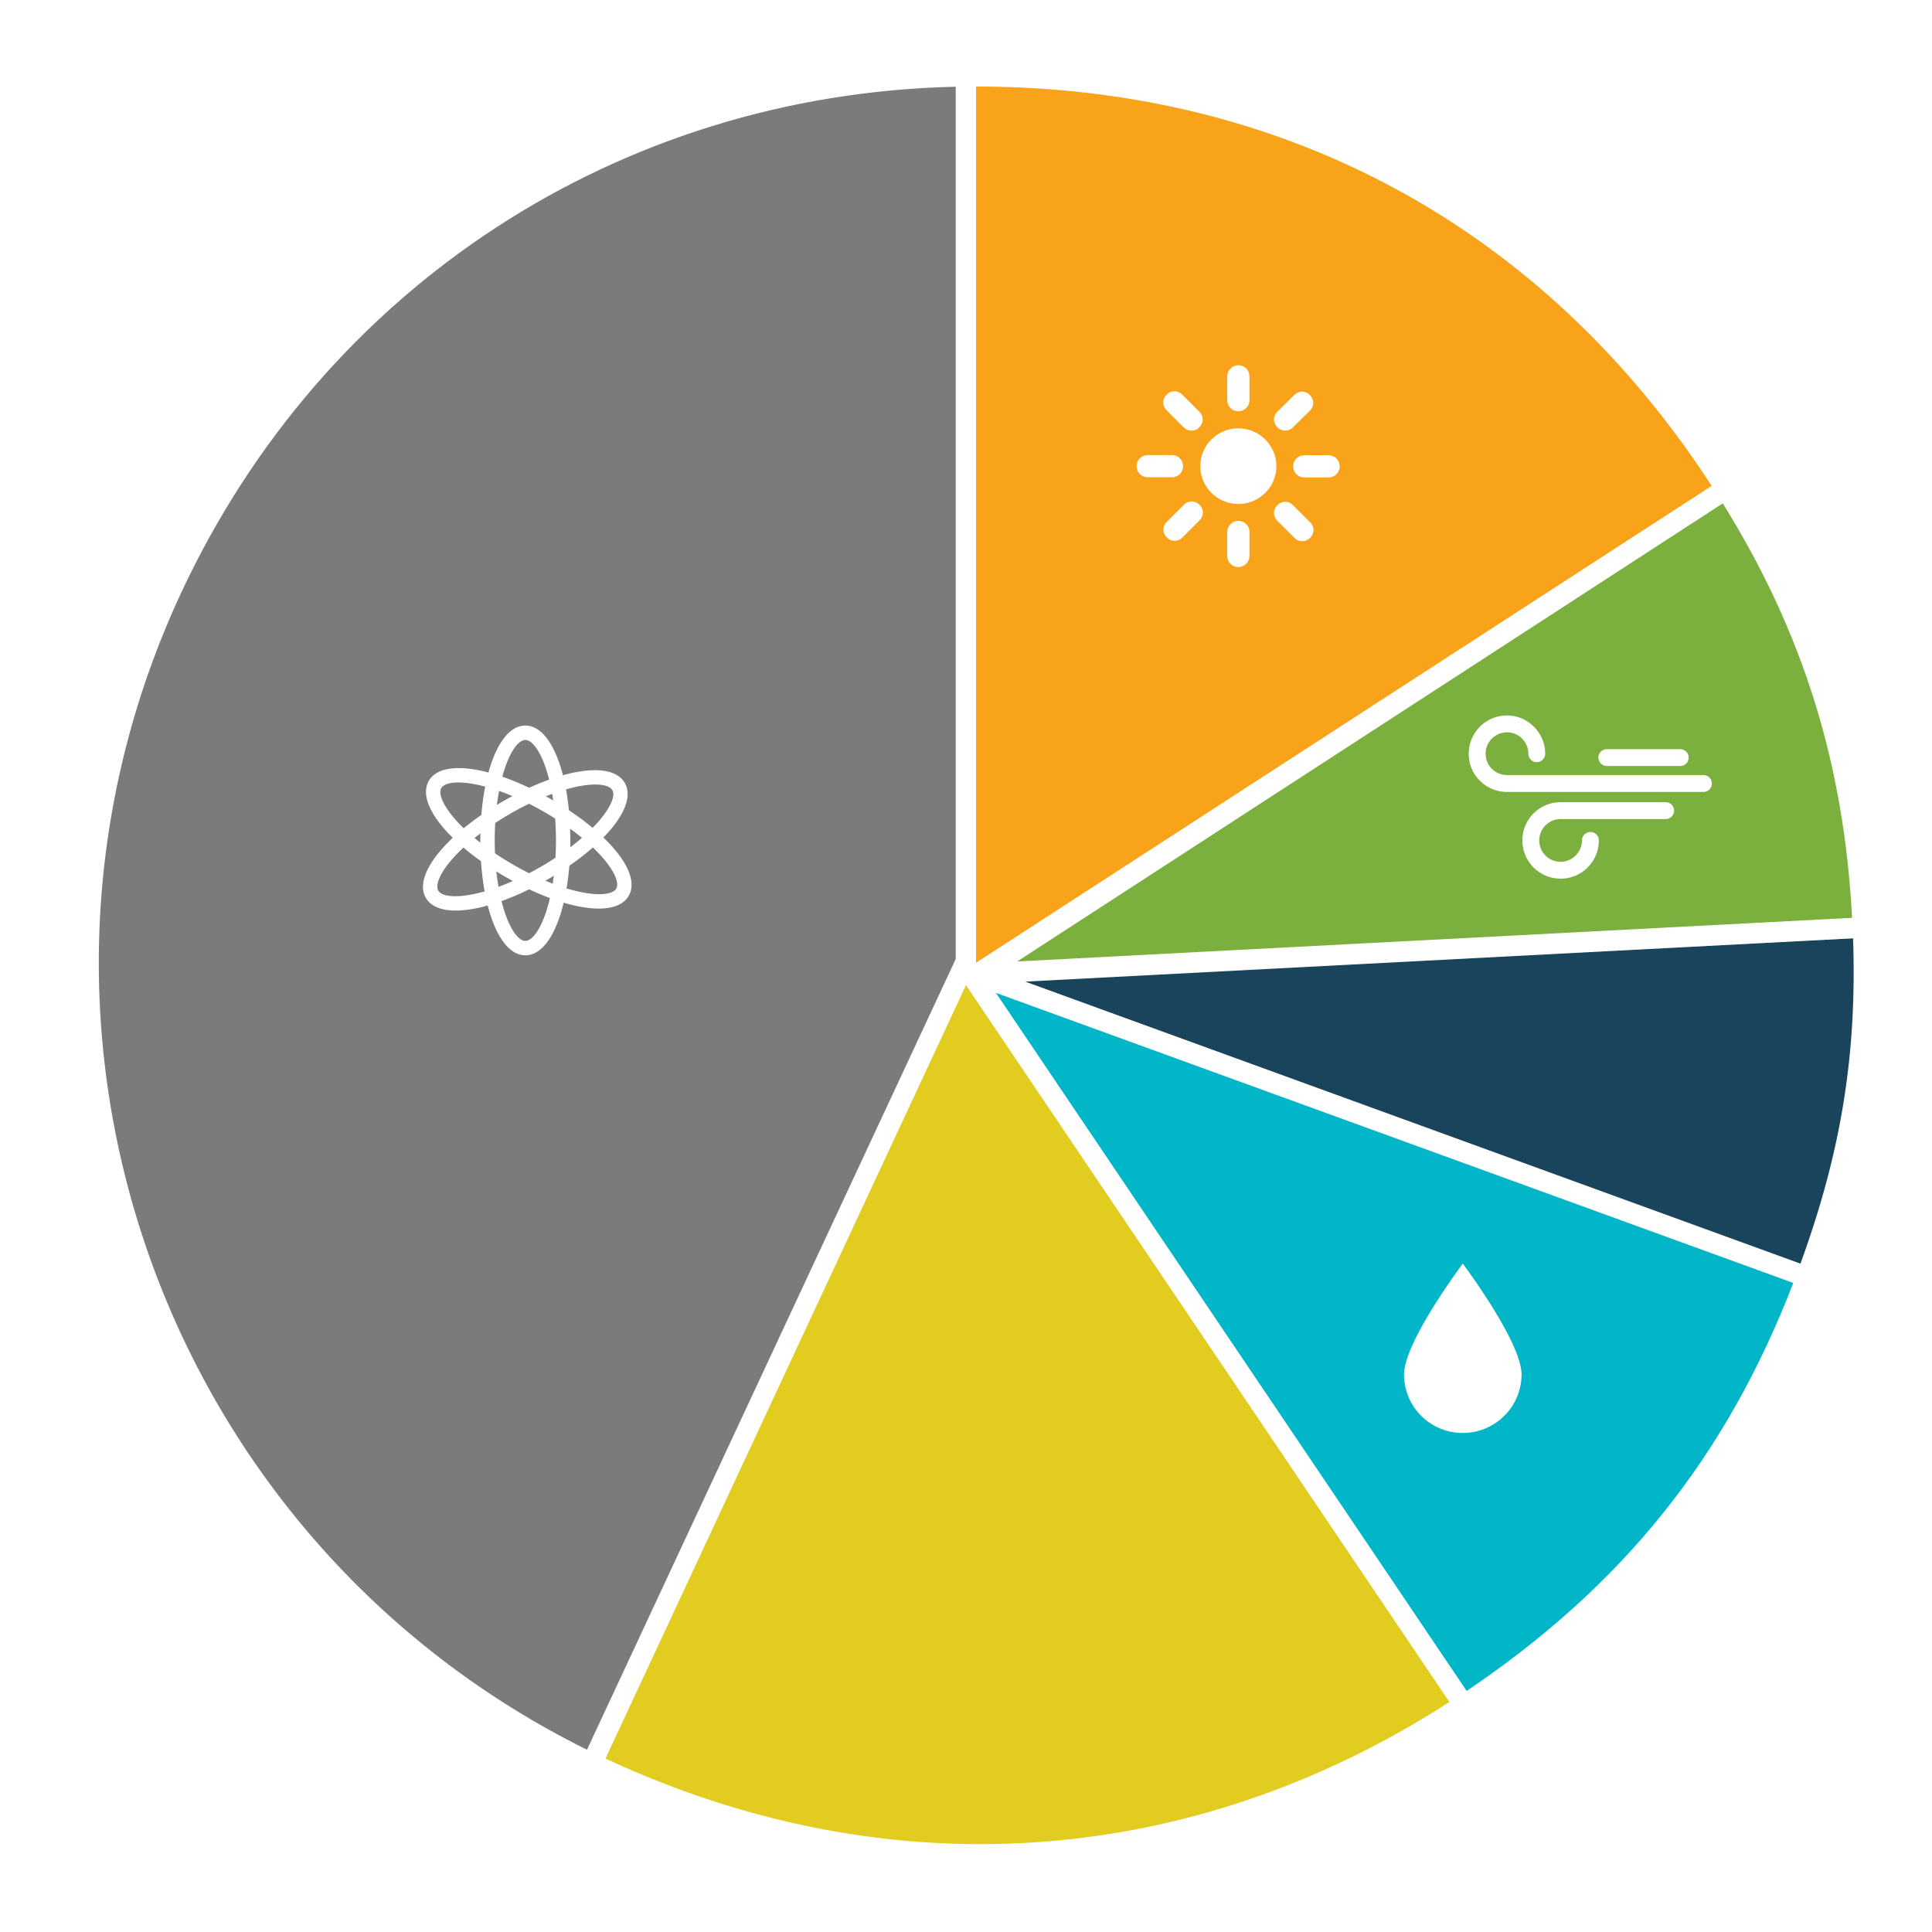
What Are My Options?
Bright Choice
50% renewable energy at rates 3% below PG&E
Renewable 100
100% California solar & wind energy at ¾ cent per kilowatt-hour above PG&E rates
PG&E
3

Slide 4
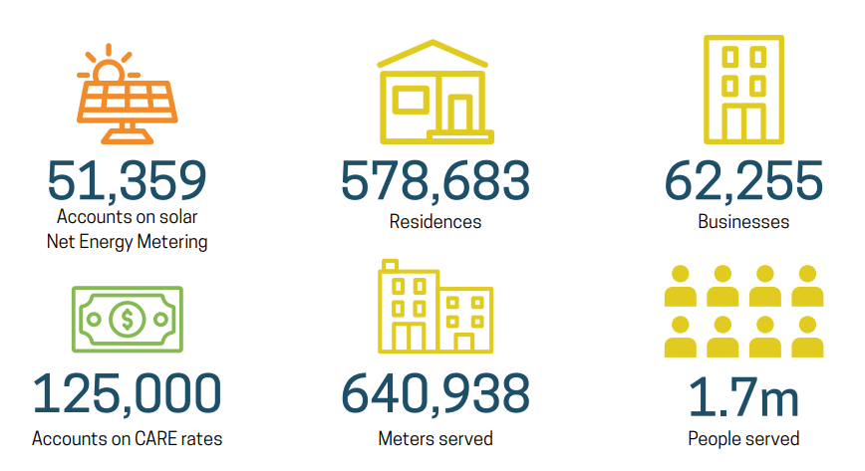
EBCE Customers at a Glance

Slide 5
Enhancing Electric Affordability: since 2020, CCAs have paid to provide tens of millions in bill credits and relief
CCAs flexibility and deep connection to our cities has allowed us to move quickly to support our consumer electricity affordability
-At East Bay Community Energy, we delivered $50 bill credits to all of our 120k CARE households last September to help offset very high summer electricity bills (which is in addition to our on-going 3% bill discount)
-Throughout the COVID pandemic, CCAs across the State delivered tens of millions of dollars in bill credits and relief from our own balance sheets to support electricity affordability

Slide 6
CCAs Are Leveraging Clean Energy Project Revenue Bonds to Deliver $25m in bill savings annually
Bond Issue | CCA Off-taker | Total Par Amount | Annual Savings ($millions)
Series 2021A | MCE | $600m | $3.2
Series 2021B | EBCE/SVCE | $1,2b | $4.2
Series 2022A | EBCE | $930m | $4.8
Series 2023A | Pioneer CE | $460m | $2.8
Series 2023B | SVCE | $841m | $4.7
Series 2023C | CPA | $999m | $8.3
Totals | 6 CCAs | $5b | $26m
-What is a Clean Energy Revenue Bond
CEPRBs are a municipal finance tool that municipal utilities and CCAs can use to structurally reduce the cost of clean energy by leveraging their tax exempt status
-How much rate relief are these bonds delivering?
Through the California Community Choice Financing Authority, 6 CCAs have issued over $5b in clean energy revenue bonds that are saving their customers over $25m a year in electricity costs.
Over the coming years, CCCFA and the CCA community expect to continue to leverage this tool to accelerate the deployment of clean energy while also lowering customer rates by hundreds of millions of dollars a year
-Can this tool scale?
Yes. CCAs can issue CEPRBs equivalent to the amount of clean energy they procure - which for EBCE will be 100% by 2030. At these levels, CCA customers across the State will be experiencing hundreds of millions of electricity bill savings

