Slide 1
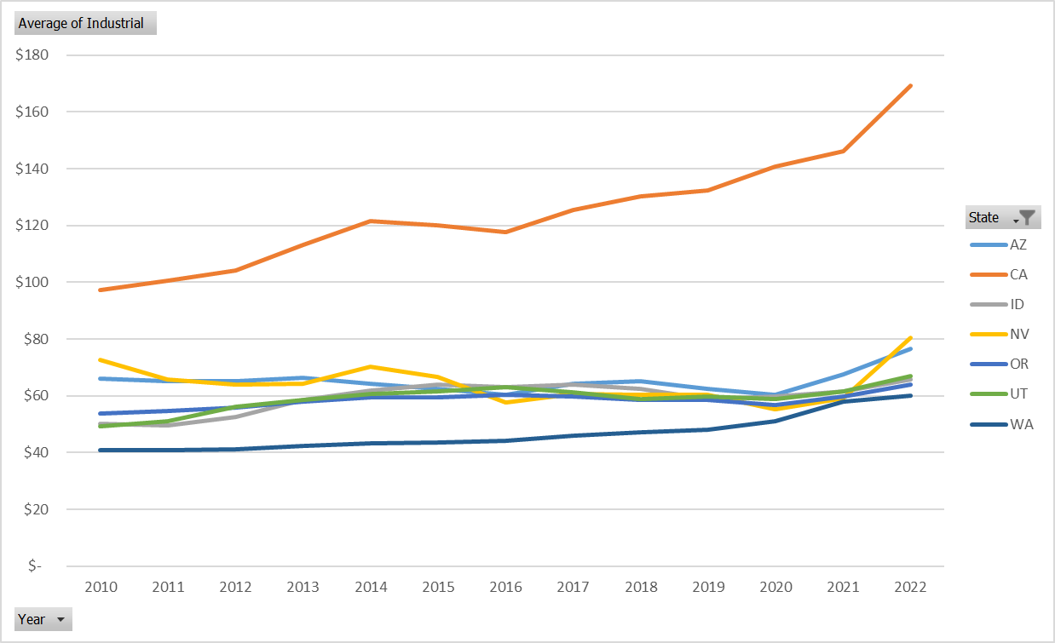
Industrial Sector Electricity Rates by State $/MWH
Energy Information Agency (EIA) Data Jan 2010 – September 2022
EIA-861M Monthly Electric Power Industry Report (released: 11/23/2022)
2010–present Monthly sales to ultimate customers by state and sector

