Slide 1
California Public Utilities Commission:
Annual Report
Overview
March 6, 2018
Senate Energy, Utilities and Communications Committee Hearing
Sacramento, CA
Timothy Sullivan, Former Executive Director
Alice Stebbins, Executive Director
California Public Utilities Commission

Slide 2
Agenda
Mission and Resources
Serving Californians: Safety
Serving Californians: Access to Infrastructure
Serving Californians: Protecting the Environment
Serving Californians: Prices and Services
Preparing to Serve: Rebuilding Administrative Core
Implementing Legislation
Implementing the Reforms

Slide 3
Purpose: Serving Californians*
Supporting Infrastructure Access
Promote Safety
Implement statutory programs to support universal telecommunication services
Support broadband deployment programs to bridge the digital divide
Implement income-qualified energy program (e.g. CARE, ESA)
Provide consumer dispute resolution to minimize service cut-offs
Conduct safety inspection of rail crossings
Inspect electric and gas infrastructure
Review regulatory filings for safety concerns
Ensure compliance of water utilities to state and federal public health requirements (lead testing)
Ensure access to tele-communication services to support public safety (e.g. 911)
Utility pole safety
Safety & Enforcement
Central Core
1. PUC administrative support and control
2. Legislative committee and control agency oversight
3. Commissioner oversight and policy direction
4. State and Federal statutory authority
Protect Environment
Traditional Regulation
Implement water conservation regulation across privately-owned water companies
Implement state laws to mitigate greenhouse gas emissions and increase use of cleaner energy resources
Support efforts by sister agencies such as Air Resources Board and California Energy Commission
Promote electrification of mobile transportation
Achieve renewable energy targets
Review license applications by passenger transportation companies
Review and audit utility costs
Review rate cases by small telephone companies, all energy utilities, and water utilities
Implement and administer new state laws on transportation network companies (e.g. Lyft)
Conduct oversight to ensure compliance with state law by regulated utilities
* Examples are illustrative, not comprehensive
Notes:
On Safety (from 2017 Annual Report page 9)
131 investigations on electrical incidents
270 investigations on natural gas incidents
323 investigations on rail transit incidents
342 non rail transportation investigations completed
$10.9 million in fines/penalties levied against energy utilities
$3.8 million in fines/penalties levied against telecommunications companies
$294,000 in fines levied against transportation companies

Slide 4
Budget
The CPUC’s budget for operations is $340.3 million for 2017-2018. This supports staff salaries, benefits, and operational expenses including contracts, travel, and facilities. In addition, the CPUC budget includes $1.3 billion in local assistance: $755 million for communications and $562 million for energy.
Appropriation |  | Authorized Positions
State Operations (Total) | $340,284,000 | 1249.2
Regulation of Utilities | $193,181,000
Regulation of Transportation | $36,866,000
Universal Service Telecommunication Programs* | $110,237,000
Administration**
* This figure includes contracted program administration and equipment expenditures for the Universal Lifeline Telephone Service Program and the Deaf and Disabled Telecommunications Programs, which for 2017-18 are projected to cost $98.34 million (adopted in CPUC Resolution T-17572).
** The costs for Administration are included in the expenditure amounts listed for each program
Source: page 52-53 of 2017 Annual Report; Resolution T-17572

Slide 5
Annual Report
Year in Review: Promoting Safety (pages 22-26)
Fire Siege Actions
Working with CalFIRE MOU
Requiring utilities to develop programs to support fire victims in restoring service and assistance in billing matters
Fire Safety Maps Independent Review Team-approved Fire Threat Map was made available for comment in November 2017. Anticipate a final Fire Threat Map in first quarter 2018.
Safety Investigations
Electrical Incidents Investigated: 131
Gas Incidents Investigated: 270
Railroad and Rail Transit Incidents Investigated: 323
Non-Rail Transportation Investigations Completed: 342
Inspections
Natural Gas Pipeline Safety Inspections: 73

Slide 6
Annual Report
Year in Review: Promoting Safety (pages 22-26)
Aliso Canyon (SB 380)
Inspection of Aliso Canyon, concurrence with DOGGR decision to open on July 19, 2018
Determining the feasibility of decreasing use or closing of Aliso in proceeding I.17-02-002
Limited use of Aliso continuing; less than 23.6 Bcf
Safety Work in Ongoing Proceedings
Pole Management (R.16-12-001)
Substation Physical Security (R15-06-009)
Safety Model Assessment (A.15-05-002)
Zero Tolerance on Drugs and Alcohol Investigation of Uber (I.17-04-009 with (2018 resolution anticipated)

Slide 7
Annual Report
Year in Review: Access to Infrastructure (pages 18-21)
Programs Supporting Access to Communications Infrastructure
Communications Lifeline program: approximately 2 million customers, including 1.5 million wireless. Local assistance for 2016-2017 was $460 million, $13.75 state discount and $9.25 federal discount per month
Deaf and Disabled Telecommunications Program: 680,000 customers with specialized equipment, 1.8 million Relay calls, $51.7 million program expenses
Advanced Services Fund (broadband infrastructure): $89.8 million local assistance (grants)
Teleconnect Fund: $145 million local assistance (50% discounts to schools, libraries, hospitals and non-profits for broadband services)
Rural High Cost Support (CHCF-A and CHCF-B): $55 million local assistance
Notes:
Lifeline: CD projects 3.2 million LifeLine customers in 2017-2018 (2.7 million wireless), and local assistance of $599.6 million.

Slide 8
Annual Report
Year in Review: Access to Infrastructure (pages 18-21)
Programs Supporting Access to Energy Infrastructure
Energy Savings Assistance Program
269,808 homes treated at no cost to customers, $275.2 million program costs
California Alternate Rates for Energy
4.4 million customers, $1.24 billion in subsidies
30-35% discount on electricity, 20% on gas
Providing Natural Gas to Disadvantaged Communities in San Joaquin Valley (AB 2672 Perea) - proceeding underway
Preventing Disconnections through customer support – 32,216 Californians assisted, secured $1 million in refunds
Access to Utility Poles
In July 2017, the Commission opened R.17-06-028 to explore safety and competition/access issues related to utility poles.

Slide 9
Annual Report
Year in Review: Regulation of Prices and Services (pp. 30-32)
Fines and Penalties
Energy Utilities: $10.9 million
Telecommunications Companies: $3.8 million
Under-remittance of Surcharges and User Fees: $23 million
Diablo Canyon Power Plant Retired
In 2017, the CPUC held seven days of evidentiary hearings into PG&E’s application to retire the Diablo Canyon Nuclear Power Plant. PG&E requested approval to recover $1.76 billion in retirement costs via rates; the CPUC ultimately approved $241.2 million in rate recovery.
San Diego Gas & Electric Wildfire Expense Memorandum Account Denied
In 2017, the CPUC denied SDG&E’s request to recover $379 million in claims incurred as a result of the Witch, Guejito, and Rice wildfires, finding that SDG&E’s operation and management of its facilities prior to the wildfires was imprudent.

Slide 10
Annual Report
Year in Review: Regulation of Prices and Services (pp. 30-32)
Regulation of Rates: PG&E 2017 General Rate Case
In 2017, the CPUC approved a settlement agreement between PG&E and 14 parties to the General Rate Case which established PG&E’s revenue requirement for 2017-2019. The CPUC made exceptions to the Settlement Agreement, including requiring more scrutiny over PG&E’s Rule 20A electric undergrounding program.
Regulation of Rates: SCE 2018 General Rate Case
In 2017, the CPUC held 15 days of evidentiary hearings and several public participation hearings. The record remains open for updated testimony and consideration of the implications of changes to federal tax law. A Decision is expected during first quarter 2018.
Regulation of Rates: Residential Rate Reform
In 2017, the CPUC adopted Decision D.15-07-001, which aligns and integrates electricity-related customer engagement campaigns across multiple different programs. In addition, the CPUC is testing and evaluating default time-of-use rate proposals for rates scheduled to be implemented in 2019.

Slide 11
Annual Report
Year in Review: Protecting the Environment (pages 34-37)
Implementing SB 350 (de León, 2015):
Greenhouse gas reduction target of 40 percent below 1990 levels by 2030
Increase renewable generation to 50 percent by 2050. This section highlights the CPUC’s major SB 350 implementation activities.
Renewables Portfolio Standard
California’s IOUs are meeting or exceeding renewables procurement requirements, and are on track to exceed the goal of 33 percent renewables by 2020. IOUs forecast that they will meet the 50 percent renewables target by 2020, ten years early.
Integrated Resource Planning
In 2017, the CPUC implemented AB 693 (Eggman, 2015), the Multifamily Affordable Housing Solar Roofs program for solar generation on multifamily housing with low income tenants and/or located in disadvantaged communities.

Slide 12
Annual Report
Year in Review: Protecting the Environment (pages 34-37)
Transportation Electrification
The Governor’s Executive Order B-16-2012 set a target of 1.5 million zero emission vehicles on California roads by 2025. In January and June 2017, the CPUC received several proposals from IOUs to enhance electric vehicle adoption and deployment. The CPUC will decide upon these proposals in 2018.
Energy Storage Procurement
In 2017, the CPUC took multiple actions to encourage energy storage, including: revising energy storage procurement targets, establishing rules for energy storage station power, and approving the IOUs’ station power tariffs.
Behind the Meter Renewables
In 2017, the CPUC implemented AB 693 (Eggman, 2015), the Multifamily Affordable Housing Solar Roofs program for solar generation on multifamily housing with low income tenants and/or located in disadvantaged communities.

Slide 13
Building the Administrative Core
Annual Report
New Leader in HR
New Leader in Administrative Services
New Deputy Executive Director for Safety and Compliance
New Risk and Compliance Officer (Pending)
New Executive Director with exceptional Administrative Expertise
Training on contracts for all participating staff

Slide 14
Annual Report
Filling Vacancies
Since July 2017, the CPUC vacancy rate has declined 8.8 percentage points, from 22.7% to 13.9%.
From January 1, 2017 to January 31, 2018 the Public Utilities Commission has hired 197.5 people into the Commission and promoted another 194.5, with 84 separations.
The CPUC has changed from its historic hiring practices, which took 191 business days, or 9.3 months to fill a vacancy to 89 business days, or 4.3 months. Process re-engineering is underway to try to reduce hiring times further.
The CPUC tracks each vacancy from the time an individual submits a resignation until the time it is filled.
Since January 1, 2017, the CPUC has worked to staff a new office in Sacramento, with 38 new hires.
The CPUC is reinventing itself, and when this wave of hiring finishes, approximately 370 new people, or 30% of the workforce, will have joined the commission by end of budget year.

Slide 15
Annual Report
Steady Progress in Filling Vacancies
Month End | Budgeted Positions | Filled Positions | Vacant Positions | Vacancy Rate
July 2017 | 1229.3 | 950.3 | 279 | 22.7%
August | 1229.3 | 970.3 | 259 | 21.1%
September | 1229.3 | 979.3 | 250 | 20.3%
October | 1229.3 | 999.3 | 230 | 18.7%
November | 1229.3 | 1018.3 | 211 | 17.2%
December | 1229.3 | 1030.3 | 199 | 16.2%
January 2018 | 1226.8 | 1037.8 | 189 | 15.4%
February | 1226.8 | 1055.8 | 171 | 13.9%

Slide 16
Administrative Reforms
Annual Report
Expanding and Updating Facilities
300 Capitol Mall. Construction began on February 1. Staff to move from 4th to 5th floor in early April.
Funds available for ADA accessibility work on bathrooms. Project is in the planning stages with DGS at this time.
Fi$Cal
Working on implementation and training
New Financial Reports
Tracking budgets vs. actuals
Monitoring Fund Balances
Tracking Federal Funding

Slide 17
Implementing Legislation pages 38-42
AB 33 Energy Storage (Quirk, 2016): The CPUC issued Decision D.17-04-039 assigning consideration of long term bulk energy storage to the Integrated Resource Planning proceeding.
AB 327 Net Energy Metering (Perea, 2013): In 2017, the CPUC requested comment on net energy metering options for disadvantaged communities.
AB 693 Clean Energy (Eggman, Williams, 2015): In December 2017, the CPUC approved D.17-12-022 creating the Solar on Multifamily Affordable Homes program.
AB 746 Water Quality in Schools (Gonzalez, 2017): The CPUC’s jurisdictional water utilities have received requests to test the water in over 400 schools. Only a few instances of unsafe lead levels have been detected; in response, old equipment at the schools has been replaced. The program ends in November 2019.
AB 1289 TNC Background Checks (Cooper, 2016): In November 2017, the CPUC adopted updated background check requirements for Transportation Network Companies (TNCs).
AB 1637 Net Energy Metering (Low, 2016): The CPUC approved new net energy metering requirements for fuel cell customers, but this Decision is under appeal.

Slide 18
Implementing Legislation pages 38-42
AB 1923 Bioenergy Market Adjusting Tariff (Wood, 2016): The CPUC adopted the capacity exemption in Decision D.17-08-021 and is addressing the interconnection modification in R.15-02-020.
AB 1979 Renewable Market Adjusting Tariff (Bigelow, 2016): In December 2017, the US District Court for the Northern District of California issued an Order preventing the CPUC from implementing the Renewable Market Adjusting Tariff and requiring the CPUC to issue new rules consistent with federal law. The CPUC is appealing the Order.
AB 2570 LifeLine Portability Freeze (Quirk, 2016): The CPUC adopted the 60 day portability freeze and 30 day enrollment request freeze in Decision D.17-01-032.
AB 2868 Energy Storage (Gatto, 2016): The CPUC adopted Decision D.17-04-039 requiring the three IOUs to solicit energy storage designs. IOU applications were due on March 1, 2018.
SB 62 Office of the Safety Advocate (Hill, Pavley, 2016): The Office of the Safety Advocate was created in 2017.
SB 92 Technical Fix (Committee on Budget and Fiscal Review, 2017): The CPUC adopted Decision D.17-12-022 adopting the technical fix clarifying the amount of funding available as 10 percent of the total electric IOU carbon allowance revenue.

Slide 19
Implementing Legislation pages 38-42
SB 215 CPUC Transparency (Leno, Hueso, 2016): The CPUC revised its Rules of Practice and Procedure in November 2017; the new rules will go into effect on April 1, 2018, after review by the California Office of Administrative Law.
SB 1383 Biomethane (Lara, 2016): The CPUC adopted a Decision approving a pilot program for the first five dairy biomethane projects in 2017.
SB 350 Clean Energy (de León, 2015): The CPUC continues to implement SB 350 in multiple proceedings, including the Renewables Portfolio Standard proceeding, and the Integrated Resources Planning proceeding.
SB 380 Aliso Canyon (Pavley, 2016): The CPUC opened the Aliso Canyon feasibility proceeding, I.17-02-002.
SB 512 CPUC Transparency and Accessibility (Hill, 2015): The CPUC implemented the requirements of SB 512 in 2017.
SB 541 CPUC Transportation Unit (Hill, 2015): The CPUC hired Crowe Horwath to conduct an assessment of the transportation unit and prepare a report.
SB 745 CASF Eligibility (Hueso, 2016): The CPUC adopted the revised eligibility requirements in 2017.
SB 1090 Time of Use Rate Reform (Fuller, 2014): The CPUC adopted the necessary consumer protections for customers in hot inland areas in 2017.

Slide 20
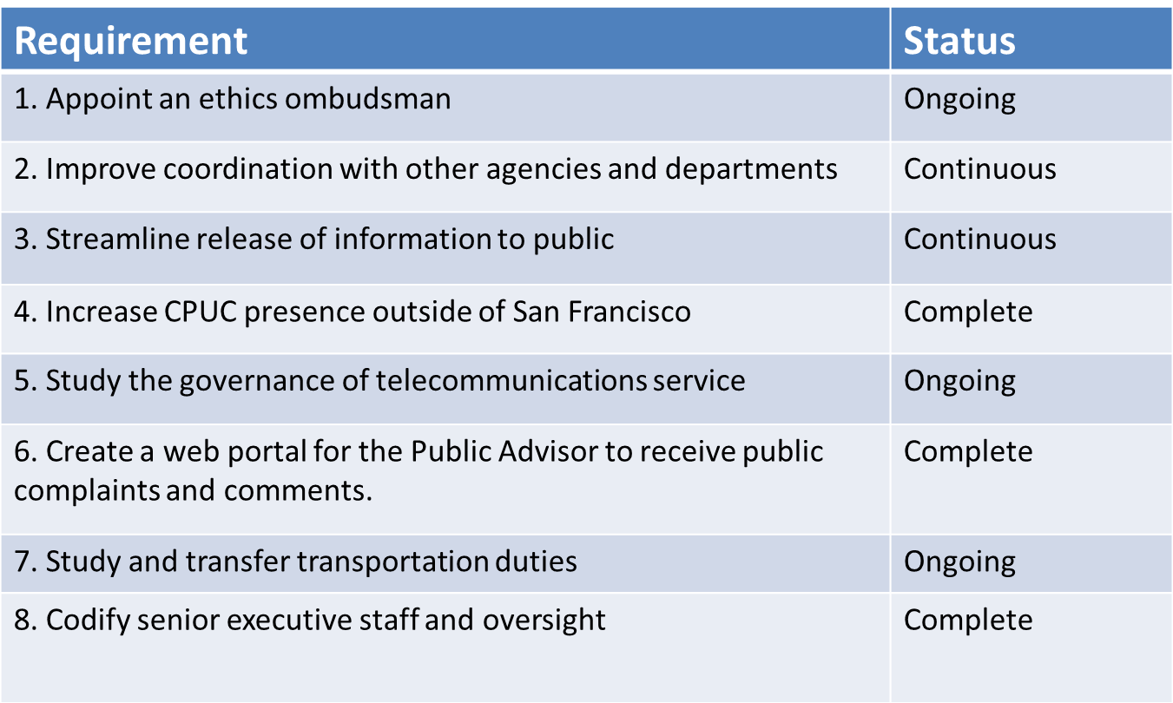
Status of Implementing CPUC Reforms
Reforms required by the Governor’s Signing Messages and by SB 19,
SB 215, SB 512

Slide 21
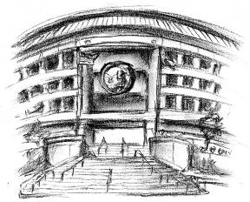
For Additional Information:
www.cpuc.ca.gov
Timothy Sullivan
Former Executive Director
California Public Utilities Commission

