Slide 1

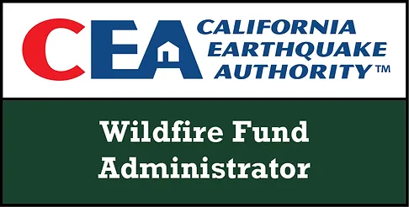
Senate Committee on Energy, Utilities and Communications
Tom Welsh, CEO
California Earthquake Authority
Wildfire Fund Administrator
Laurie A. Johnson PhD FAICP
SB 254 Research Study Director
Andy Neal, FSA
Senior Managing Director of Public Sector Partnership
AON
Informational Hearing
Tuesday, May 12, 2026 – 9:00 a.m.

Slide 2

SB 254 Catastrophe Resiliency Study
Overview of the Report
Study Background
Study Scope and Process
Study Recommendations
Related to the Utility Sector

Slide 3

The Context for SB 254 and the Study
SB 254
Context of SB 254 (2025, Senator Becker, Assemblymember Petrie-Norris)
  2017-18 Wildfire Season
  PG&E Bankruptcy
  Downgrades of IOUs
  Crisis Solution – AB 1054 (2019) & the California Wildfire Fund
  January 2025 LA Wildfires
SB 254 – Key Provisions Relevant to the Wildfire Fund
  “Continuation Account” – Created within the Wildfire Fund a new, segregated account with up to $18 billion in capacity for IOU-linked wildfires ignited after September 19, 2025
  “The Study” – Enacted Public Utilities Code section 719 – Requiring CEA to undertake the SB 254 Study

Slide 4
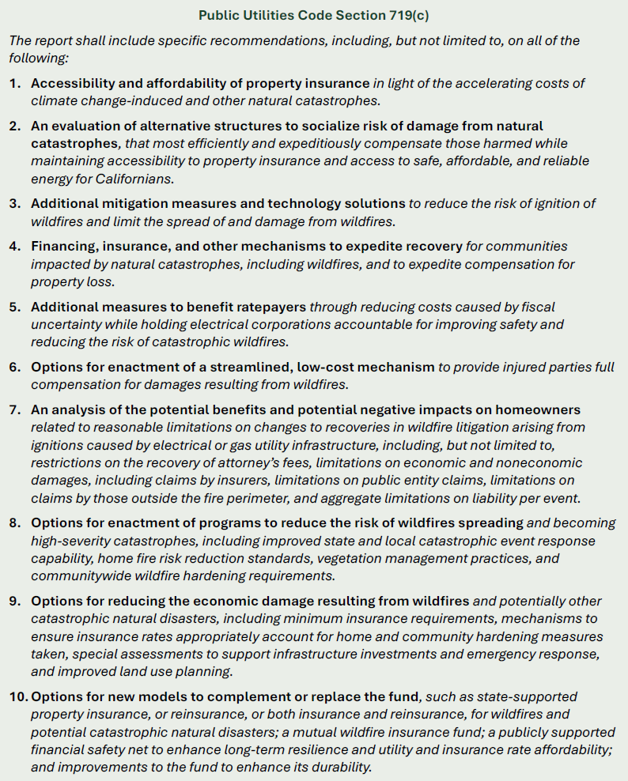
Study Scope & Process
SB 254
Broad Scope of the Study
Key Stated Objectives:
Accelerate Recovery
Responsibly and Equitably
Allocate the Burdens and Costs of
Catastrophes
Mitigate Damage
“Whole of Government Approach” – With
leadership from Governor Newsom through
Executive Order N-34-25
“Whole of Society” Research Study Process

Slide 5
Stakeholder Engagement – Open Call for Submissions
SB 254
83 responses from 65 unique organizations/individuals, all available on CWF website
Includes all SB 254 mandated stakeholder groups (ratepayer advocates, insurance policyholder advocates, electrical corporations, insurance companies, and claimant attorneys)
Utilities & Energy Sector | Insurance & Financial Sectors | Consumer & Survivor Advocates & Attorneys | Mitigation Technology & Advisory | Local Government | Environmental, Policy & Academic
American Clean Power Network California Municipal Utilities Association (CMUA) California Water Association (CWA) and Association of California Water Agencies (ACWA) California Association of Mutual Water Companies (CalMutuals) JPRIMA Golden State Power Cooperative Los Angeles Department of Water and Power (LADWP) Liberty Utilities (CalPeco Electric) NextEra Energy Transmission Paradise Irrigation District (PID) PG&E SDG&E/Sempra Southern California Edison (SCE) | APCIA-PADIC-RAA BofA Securities Coalition for Sustainable Flood Insurance (CSFI) Insurance Institute for Business & Home Safety (IBHS) McKinsey & Company Milliman PIFC-NAMIC | Affordable Energy Campaign C. Brown Claimant Attorneys of California (CAOC) Consumer Watchdog Eaton Fire Residents United Eaton Fire Survivors Network K. Girard, PhD M.J. Lee M. Szarama The Utility Reform Network (TURN) Utility Wildfire Survivor Coalition | ASTM Task Group California Conservation Corps Foundation California Farm Bureau Filsinger Energy Partners FireAside Firescape Inc. Frontline Wildfire Defense IND Technology Mariposa Resource Conservation District Matador Fire Megafire Action ROCKWOOL Vibrant Planet | California State Association of Counties (CSAC) Rural County Representatives of California (RCRC) League of California Cities (Cal Cities) Town of Los Gatos | Allotrope Cellulosic Development Company Blue Forest California Alliance for Community Energy Climate & Community Institute (CCI) Darwin Fund Environmental Defense Fund (EDF) Greenthread and Resilience Investments Independent Institute Natural Resources Defense Council Putting California's Assets to Work Reclaim Our Power! Utility Justice Campaign Sierra Business Council (SBC) Southern California Ignition Reduction Program (SCIRP) The Nature Conservancy (TNC) UC Berkeley, Goldman School of Public Policy UCLA Luskin Center for Innovation

Slide 6
Study Process - Stakeholder Engagement
SB 254
SB 254 Mandated Stakeholder Groups
Engagement Type | Ratepayer Advocates | Insurance Policyholder Advocates | Electric Corporations | Insurance Companies | Claimant Attorneys
Open Call Submissions | 11 | 8 | 8 | 6 | 1
Workstream Engagements (Meetings, Focus Groups, Written) | 8 | 12 | 20 | 21 | 2
Total 97 | 19 | 20 | 28 | 27 | 3
Other Key Stakeholder Groups
Engagement Type | Other Legal + Regulatory Advocates | Survivor Orgs/Reps | Local Gov’t/ Tribes | Public Utilities | Gas Utilities | Financial Sector | Industry/ Technology | Other Private Enterprise | Climate Resilience/ environment | Philanthropy
Open Call Submissions | 24 | 9 | 9 | 6 | 2 | 1 | 9 | 9 | 13 | 0
Engagements (Meetings, Written) | 34 | 7 | 9 | 10 | 8 | 15 | 2 | 7 | 24 | 4
Total 202 | 58 | 16 | 18 | 16 | 10 | 16 | 11 | 16 | 37 | 4
Notes:
@Laurie Johnson I ended up grouping some of the Other stakeholders together for space.
-------------
You can find the excel version of these tables here: Agency-ConsultantMeetingScheduleWorksheet-JkY-DRAFT.xlsx
--------------------
The touchpoint source document is here:
Combined WS Stakeholder Touchpoint Tracker.xlsx

Slide 7
Report – The Cost of Inaction is High
SB 254
Without meaningful intervention, these catastrophe-related risks will get worse.
Inaction perpetuates unaffordability for utility ratepayers. Utility companies become increasingly unattractive to investors and lenders, limiting their ability to attract the capital required to maintain safe, clean, and reliable infrastructure, let alone the capital needed to finance the improvements needed to reach California’s electrification and clean energy goals.

Slide 8
Recommendations (with a Focus on the Utility Sector)
SB 254
The Report presents three Policy Pathways, with Strategies and Options for each
  Pathway 1 – Commit to Community Wildfire Risk Reduction
  Pathway 2 – Equitably Allocate Catastrophe Burdens
  Pathway 3 – State Roles in Catastrophe Resiliency
3 Policy Pathways
9 Strategies
28 Options
High-level policy directions that organize related approaches to addressing wildfire risk, cost, and resilience challenges.
Thematic groupings within each pathway that define specific areas of focus for action.
Discrete policy actions or tools within each strategy that can be advanced individually or in combination.

Slide 9
Pathway 1 – Commit to Community Wildfire Risk Reduction
SB 254
Builds on California’s Utility Sector investments in system ignition risk reductions and management accountability.
Strategies | Options
1.3: Continue to Prioritize Electric Utility Safety and Accountability | 1.3.1: Develop a risk tolerance standard with binding application to electric utility liability. 1.3.2: Preserve safety Certificate accountability and financial stabilization benefits. 1.3.3: Establish a statutory minimum safety weighting in electric utility executive compensation. 1.3.4: Establish a confidential reporting system with statutory safe-harbor protections.

Slide 10
Pathway 2 – Equitably Allocate Catastrophe Burdens
SB 254
Offers a framework for strengthening existing systems relied upon to finance and distribute wildfire costs across stakeholders — reducing volatility, improving market function, and aligning financial incentives with resilience and broader state policy goals.
Strategies | Options
2.2: Reform Utility Liability | 2.2.1: Eliminate inverse condemnation for electric and gas utility-caused wildfires. 2.2.2: Modify the damages for which electric and gas utilities are liable outside of inverse condemnation. 2.3.3: Eliminate insurance subrogation.
2.3: Efficiency and Compensation Improvements for Utility-caused Wildfires to Accelerate Recovery and Reduce Legal Costs | 2.3.1: Create a “fast pay” facility for survivors of utility-caused wildfires.
2.4: Make a More Durable, Permanent Wildfire Fund | 2.4.1: Create a more durable Wildfire Fund with potential to use risk transfer. 2.4.2: Create a more durable Wildfire Fund with diversified funding sources. 2.4.3: Establish a more durable Wildfire Fund along with liability reforms.

Slide 11
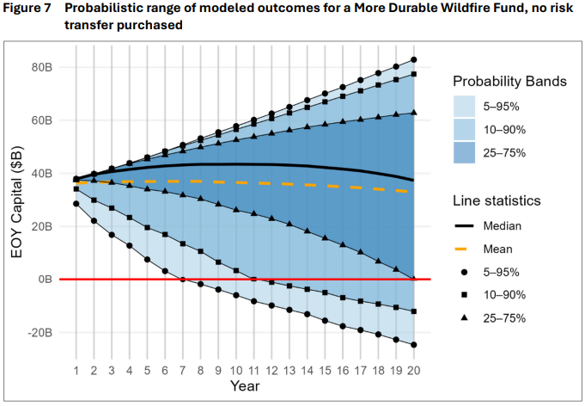
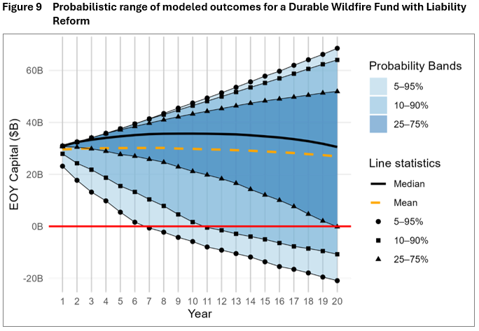
Strategy 2.4: Make a More Durable, Permanent Wildfire Fund
SB 254
Option 2.4.1: Create a more durable Wildfire Fund with potential to use risk transfer.
Capitalizes the Wildfire Fund to $36 billion - projected to last for 20 years with 75% probability.
No Risk Transfer - $11.00 in monthly Fund-related charges for an average ratepayer (compared to a current $2.50); Additional $8.50 surcharge per month if replenishment were required
With Risk Transfer - $14.75 in monthly Fund-related charges for an average ratepayer (compared to a current $2.50); protects against replenishment surcharge
Option 2.4.3: Establish a more durable Wildfire Fund along with liability reforms.
Capitalizes the Wildfire Fund to $29 billion - projected to last for 20 years with 75% probability.
Eliminates punitive damages, caps non-economic damages, public entity property damage recovers diminution in value, eliminates public entity non-property recovery, limits additional living expenses recovery
$7.00 in monthly Fund-related charges for an average ratepayer (compared to a current $2.50); additional replenishment may be required
Notes:
Capitalizes the Wildfire Fund at a level projected to last for 20 years with 75% probability.
Expands capital inflows to the Fund.
Uses risk transfer such as traditional reinsurance, parametric insurance or insurance linked securities to increase claim-paying capacity of the Fund.
Maintain the AB 1054 safety Certificate framework and require full compliance with all statutory conditions as a prerequisite for participating in the Fund.
Maintain the AB 1054 cap on required utility reimbursement to the Fund, limiting shareholder responsibility for disallowed wildfire costs to no more than 20% of the utility’s total transmission and distribution equity rate base, subject to statutory exceptions.

Slide 12
Pathway 3 – State Roles for Addressing Catastrophe Resiliency
SB 254
Considers potential State roles to fill property insurance and utility liability coverage gaps, stabilize interconnected systems, and build long-term fiscal capacity for catastrophe risk financing and statewide risk reduction.
Strategies | Options
3.1: State Roles to Finance Catastrophe Risk | 3.1.1: Establish a State-administered wildfire liability insurance program for electric utilities. 3.1.2: Establish a State-backstop for electric utility wildfire liability with a residual utility self-insurance pool. 3.1.3: Establish a State-backed catastrophe reinsurance layer for the residential property insurance market. 3.1.4: Create a State-sponsored wildfire insurer.
3.2: Statewide Funding for Community Wildfire Mitigation | 3.2.1: Develop a long-term funding and financing strategy for statewide community wildfire mitigation.

Slide 13
Pathway 3 – Strategy 3.1 State Roles to Finance Catastrophe Risk
SB 254
Option 3.1.1: Establish a State-administered wildfire liability insurance program for electric utilities.
Each participating utility pays a premium for coverage and passes these costs on to ratepayers.
Program provides coverage for utility payouts above a per-event deductible(i.e., $1 billion for large IOUs) and subject to a utility co-pay (i.e., 20%) above the deductible.
Overall utility outlays capped at 20% of the Transmission and Distribution Equity Rate Base (e.g., would be ~$4 billion for SCE).
If accumulated premiums are insufficient to cover losses, State provides a backstop, funded by bond issuances against utility premiums or other State-level sources.
Small shortfalls could be structured as State loans to the program. Assessments could also be imposed up front to build fund capital.
Option 3.1.2: Establish a State-backstop for electric utility wildfire liability with a residual utility self-insurance pool.
A package of utility liability cost-containment measures are adopted.
State-sponsored backstop is triggered once aggregate wildfire losses exceed the capacity of the fund up to a known limit.
Attachment point for the State-sponsored backstop determined by actuarially modelled loss amounts that would be periodically re-evaluated as the risk landscape changes.
  Example: $4 billion attachment point estimated for 1-in-10-year loss level. Utilities self-insure losses below, and State-backstop covers losses above that point.
State funding could come from a temporary post-event sales tax or other broad-based assessment.
  Example: For a 1-in-100-year loss estimated at $25 billion, utilities would self-insure losses below $4 billion and State backstop would cover $21 billion. A ½-cent sales tax would yield ~$3.5 billion; a 1-cent sales tax would yield ~$7 billion. Losses to the fund could be paid through a 6- to 7-year temporary ½-cent sales tax, or a 3-to-4-year 1-cent temporary sales tax.
Both could be available to all electric utilities in the state, including IOUs, POUs, and SMJUs.
Notes:
California has created several entities to help manage disaster risk, including the CEA, the Wildfire Fund, and the FAIR Plan. As noted in this Report, these structures face challenges and require improvements. Other states and countries have established state-sponsored mechanisms to address natural catastrophe risk, including the FAIR Plans and wind pools around the U.S., Federal approaches to flood and terrorism, and natural catastrophe financing approaches in countries such as Australia, France, New Zealand, Spain, and the United Kingdom. Among these examples, California is unique in needing to address the “tail risk” of electric utility liability for wildfires caused by their equipment or operations.
Introducing a revised role for the State of California in managing financing aspects of wildfire catastrophe risk could unlock solutions that are not feasible within the current framework. In particular, new or revised State-sponsored structures can:
Enable expansion of broad cost sharing and scaling for catastrophe risk: By pooling risk across a wide base of policyholders, taxpayers, or regions, the State can spread the financial impact of low‑probability, high‑severity wildfires. This broader risk base makes it more practical to provide coverage for extreme losses that would otherwise be unaffordable or unavailable in the private market. A State-sponsored structure can also be calibrated to scale up in response to very large events, helping to maintain solvency and support rapid recovery.
Address gaps in current recovery and protection systems: A State-sponsored mechanism can be designed to complement, rather than replace, private insurance and existing catastrophe risk financing programs by filling gaps, at least for as long as those gaps persist. The regulatory reforms in the SIS have the potential to at least partially fill the gap that shows up in the lack of access to fulsome insurance in high-risk and very-high-risk areas of the state, yet the private market have been slow to take advantage of the opportunity to meet that need. Holistically, gaps currently exist in utility liability coverage, uncapitalized catastrophe “tail” risk in the FAIR Plan, and earthquake and flood insurance. Protection gap enterprises can reduce volatility in and stabilize the insurance and energy markets.

Slide 14
Pathway 3 – Strategy 3.1 State Roles to Finance Catastrophe Risk
SB 254
Option 3.1.3: Establish a State-backed catastrophe reinsurance layer for the residential property insurance market.
Voluntary State-established reinsurance program to offer quota share coverage to insurers for geographic areas where they have high concentrations of risk.
Provides a level of post-catastrophe insolvency protection for home insurers who have concentration risk is high-fire-risk areas of California.
Reinsurance priced actuarially and cost passed through to policyholders (i.e., included in premium rates). Different quota share coverages could be available (e.g., share in 25%, 50% or 75% of insured wildfire losses).
To address utility wildfire liability, this option could be combined with 3.1.1 (State-administered wildfire liability insurance program for utilities).
Option 3.1.4: Create a State-sponsored wildfire insurer.
A State-sponsored insurance program for wildfire property losses separates catastrophic wildfire risk from the standard homeowners policy and insures it through a mandatory, State‑backed wildfire policy. Wildfire would be defined as a wildfire or conflagration over a certain level of insured loss and excluded from all homeowners policies.
Homeowners insurer would provide policy and wildfire claims administration (with costs reimbursed) but with funding from the State-sponsored insurer’s assets.
Concept contemplates a waiver of subrogation rights against utilities after utility-caused wildfires, relieving ratepayers of a portion of wildfire costs.
Creates high-concentration of wildfire risk on a single balance-sheet, making risk diversification challenging.
Expected to expand insurance availability in the WUI, and lead to a smaller CA FAIR Plan.
Notes:
California has created several entities to help manage disaster risk, including the CEA, the Wildfire Fund, and the FAIR Plan. As noted in this Report, these structures face challenges and require improvements. Other states and countries have established state-sponsored mechanisms to address natural catastrophe risk, including the FAIR Plans and wind pools around the U.S., Federal approaches to flood and terrorism, and natural catastrophe financing approaches in countries such as Australia, France, New Zealand, Spain, and the United Kingdom. Among these examples, California is unique in needing to address the “tail risk” of electric utility liability for wildfires caused by their equipment or operations.
Introducing a revised role for the State of California in managing financing aspects of wildfire catastrophe risk could unlock solutions that are not feasible within the current framework. In particular, new or revised State-sponsored structures can:
Enable expansion of broad cost sharing and scaling for catastrophe risk: By pooling risk across a wide base of policyholders, taxpayers, or regions, the State can spread the financial impact of low‑probability, high‑severity wildfires. This broader risk base makes it more practical to provide coverage for extreme losses that would otherwise be unaffordable or unavailable in the private market. A State-sponsored structure can also be calibrated to scale up in response to very large events, helping to maintain solvency and support rapid recovery.
Address gaps in current recovery and protection systems: A State-sponsored mechanism can be designed to complement, rather than replace, private insurance and existing catastrophe risk financing programs by filling gaps, at least for as long as those gaps persist. The regulatory reforms in the SIS have the potential to at least partially fill the gap that shows up in the lack of access to fulsome insurance in high-risk and very-high-risk areas of the state, yet the private market have been slow to take advantage of the opportunity to meet that need. Holistically, gaps currently exist in utility liability coverage, uncapitalized catastrophe “tail” risk in the FAIR Plan, and earthquake and flood insurance. Protection gap enterprises can reduce volatility in and stabilize the insurance and energy markets.

Slide 15

Next Steps
Legislative Focus on Catastrophe Resiliency
The Study & Report
Tools to Aid Policymakers in the Balancing Between Competing Objectives
19

