Slide 1

California Gasoline Price Spike
Market Overview & Contributing Factors
March 24, 2015
Gordon Schremp
Energy Assessments Division
California Energy Commission
gordon.schremp@energy.ca.gov
California Energy Commission

Slide 2
Objectives
California gasoline market overview
Historical perspective on gasoline prices
Factors that can impact fuel prices
Reasons why gasoline prices normally increase each spring
The anatomy of a price spike & highest price increases
2015 gasoline price changes & key events
Breakdown of gasoline price components
Factors contributing to the 2015 gasoline price spike
Concluding remarks
California Energy Commission

Slide 3
California Gasoline Market - Isolated
California’s gasoline market is nearly self-sufficient, so supplies of gasoline from outside of California are not routinely needed to balance out supply with demand
  Imports of gasoline and blending components account for only 3 to 6 percent of supply
The California market is geographically isolated from other locations in the United States that produce refined products
Pipelines connect California refining centers to distribution terminals in Nevada and Arizona, but these pipelines only operate in one direction – sending gasoline and other transportation fuels to these neighboring states
California market is isolated by time and distance from alternative sources of re-supply during unplanned refinery outages
California Energy Commission

Slide 4
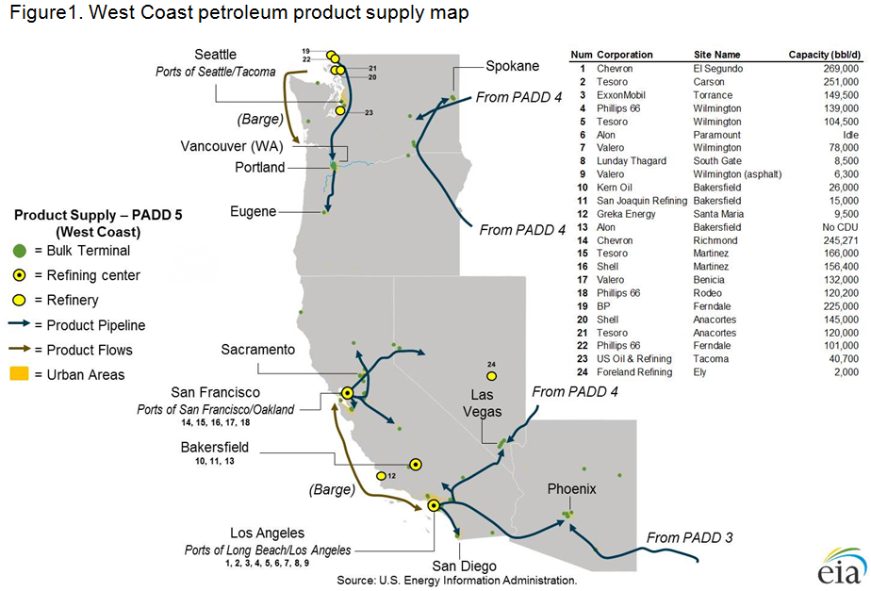
Western States More Isolated than Rest of U.S.
California Energy Commission

Slide 5
California Gasoline Market – More Expensive
California has one of the more expensive retail gasoline and diesel fuel prices in the United States
Reasons why California retail prices are more expensive:
  Greater tax burden – 15 cents
  Higher production costs – 10 cents
  Fuels-under-the-cap obligation costs – 10 cents
  An isolated market – 10 cents and more
Since January of 2001, annual average prices are at least:
  17 cents per gallon higher than the average U.S. retail gasoline price
  12 cents per gallon higher than the average U.S. retail diesel price
Between 2009 and 2014, differentials have averaged
  35.2 cents per gallon higher for gasoline
  19.9 cents per gallon higher for diesel fuel
California Energy Commission

Slide 6
California Energy Commission

Slide 7
Factors Impacting Fuel Prices
Transportation fuel prices are primarily impacted by:
  Changes in crude oil price
  Changes in wholesale price
Crude oil is a global commodity & prices fluctuate due to:
  Increasing supply from non-OPEC countries, such as the United States
  Geopolitical events that increase risk of supply disruption
  Rising or falling global demand for oil
  Heightened activity in the futures market as an alternative investment opportunity
  Value of U.S. dollar to other currencies, a stronger dollar will place downward pressure on global crude oil prices
California Energy Commission

Slide 8
Factors Impacting Fuel Prices (cont)
Wholesale fuel prices impacted by:
  Unplanned refinery outages
  Return-to-service delays by refineries undergoing planned maintenance
  Transition from winter to summer gasoline recipe that decreases gasoline production capability of refineries
  Introduction of new environmental fees
  Changes in fuel regulations, such as reformulated gasoline and transition away from MTBE
  Changes in futures contract prices linked to wholesale prices
  Unusually high or low fluctuations of fuel inventory levels
  Changes in the level of taxes on fuels
  Transition from summer to winter gasoline recipe that increases gasoline production capability of refineries
  Resumption of operations by temporarily idled refineries
California Energy Commission

Slide 9
Factors Related to Seasonal Rise
California gasoline prices normally increase at the start of each year due to a number of factors:
  Demand for gasoline is usually at the low point during January and steadily increases up through the summer months
  Transition from winter to summer gasoline decreases gasoline production capability of refineries by 5 to 8 percent
    This change begins during the second week of February for Southern California and a month later for Northern California
  Planned refinery maintenance work that takes longer than anticipated, delaying resumption of fuel production and decreasing inventories
  All of these factors place upward pressure on gasoline prices
  Declining crude oil prices, however, can mask the normal rise in retail gasoline prices
California Energy Commission

Slide 10
Seasonal Gasoline Price Increase
California retail gasoline prices have increased at the start of each year since 2011 by a minimum of 60 cents per gallon.
California Energy Commission

Slide 11
Anatomy of a Price Spike
California’s gasoline market is nearly self-sufficient, so supplies of gasoline from outside of California are not routinely needed to balance out demand with imported supplies
This means that when a significant unplanned refinery outage occurs in California, the isolated nature of our gasoline market precludes rapid resupply from outside the state
Refiners have contractual obligations to supply roughly 80 to 95 percent of what they normally produce
The refiner that experienced the unplanned outage must therefore acquire alternative sources of gasoline from other refiners and gasoline marketers in the state who are willing to sell a portion of their gasoline inventory at a higher price to cover their near-term contractual obligations
California Energy Commission

Slide 12
Significant price spikes unrelated to crude oil are infrequent and usually associated with unplanned refinery outages during periods of low fuel inventory levels. Spikes can also be associated with petroleum pipeline closures, hurricanes and strikes.
Source: California Energy Commission analysis of Energy Information Administration data.
California Energy Commission

Slide 13
California Energy Commission

Slide 14
California Energy Commission

Slide 15
2015 Gasoline Price Spike - Factors
Two refineries impacted – 17.6 percent of California refining capacity for those facilities that produce California spec. gasoline
California Energy Commission

Slide 16
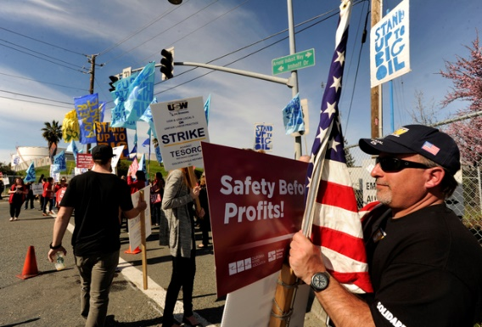
Strike Prevents Refinery Restart – Feb. 1st
Tesoro Golden Eagle refinery in Martinez, CA given strike notice – Feb. 1
Refinery was conducting planned maintenance on half of process units
Company announces decision to idle remaining process units rather than attempt to restart idle units – Feb. 2
Tesoro announces that all refinery units have been safely idled and the facility will be operated as a terminal – Feb. 6
  9.3 percent of state refining capacity
National refinery worker strike reaches a new four-year agreement – March 12
Once the new contract is ratified, workers will return, enabling Tesoro to restart the facility – will benefit supply
Source: Susan Tripp Pollard/Bay Area News Group.
California Energy Commission

Slide 17
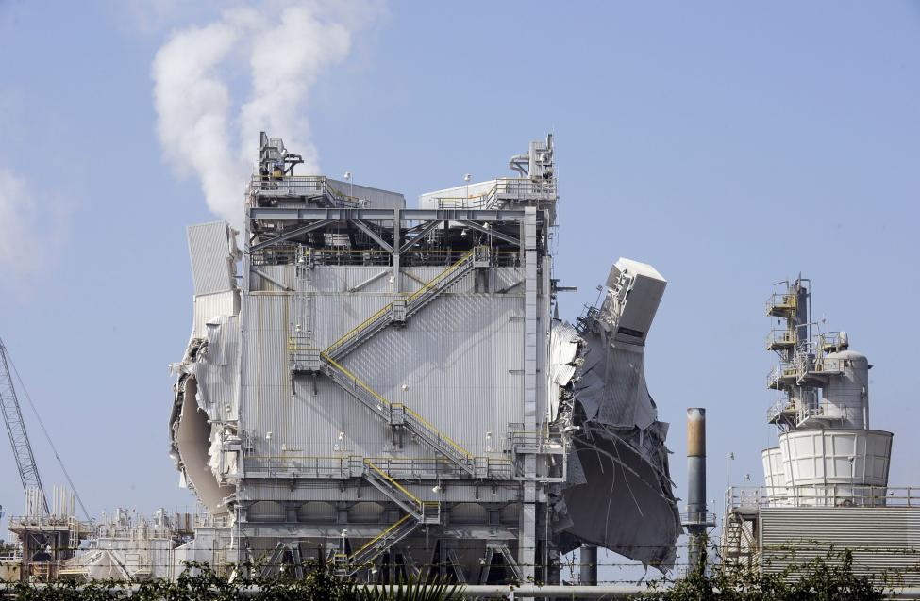
Exxon Mobil Refinery Explosion – Feb. 18th
Explosion occurs at Exxon Mobil refinery in the morning
Involves electrostatic precipitator (ESP), pollution control device
Refinery gasoline units unable to operate following ESP outage
  8.3 percent of state refining capacity
According to company, supplies nearly 10 percent of gasoline to the state
Trade publication reports refinery could resume operation of gasoline units, at reduced rates, using older ESP unit after being refurbished – uncertain return date
This action will benefit supply
Source: Bob Riha, Reuters.
California Energy Commission

Slide 18
California Gasoline Inventories
California Energy Commission

Slide 19
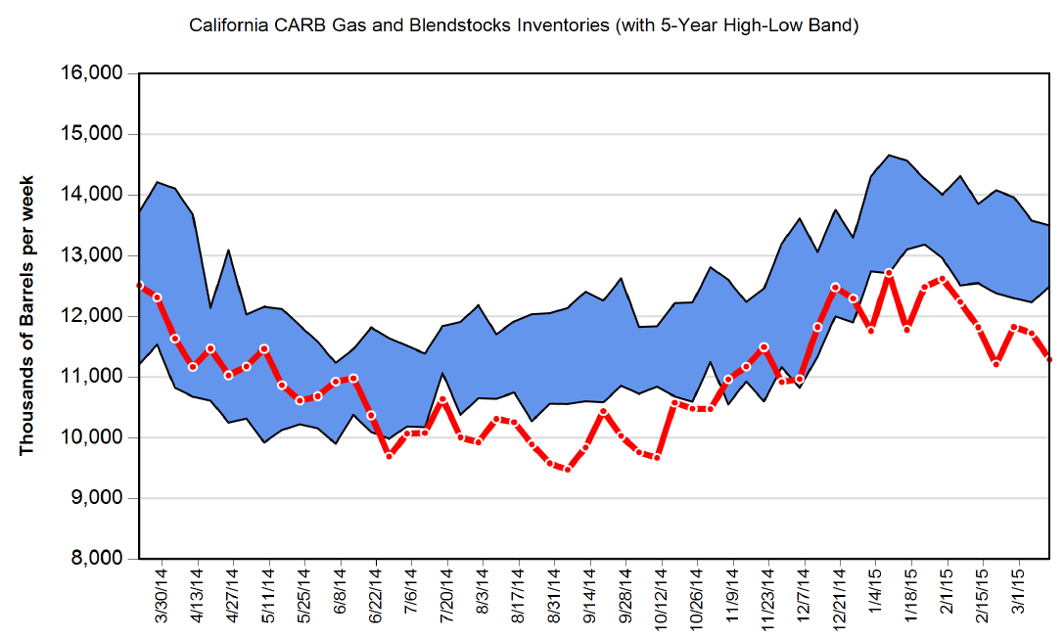
California Gasoline Inventory Levels
Current vs. 5-year High-Low Band
California gasoline inventories have been lower-than-normal for all of 2015 – scarcer stock levels can exacerbate price responses to refinery issues.
Data through March 13, 2015
Tesoro refinery strike
Exxon Mobil refinery outage
Source: California Energy Commission analysis of Petroleum Industry Information Reporting Act data.
California Energy Commission

Slide 20
Gasoline Inventory Levels
“Days of Supply” Comparisons
California Energy Commission

Slide 21
Gasoline Inventory Levels
“Days of Supply” Comparisons
California Energy Commission

Slide 22
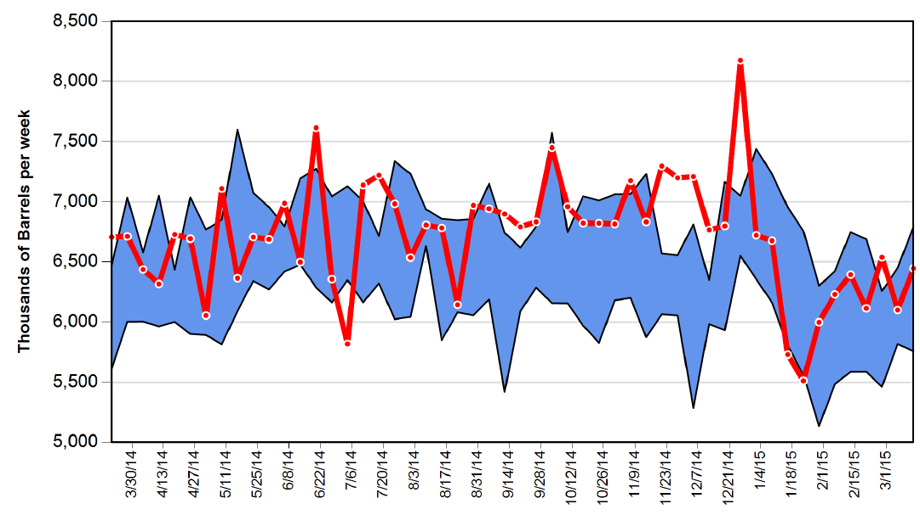
California Gasoline Production
Current vs. 5-year High-Low Band
Source: California Energy Commission analysis of Petroleum Industry Information Reporting Act data.
California gasoline production continues through use of gasoline blendstock from refinery inventories.
Tesoro refinery strike
Data through March 13, 2015
Exxon Mobil refinery outage
California Energy Commission

Slide 23
Concluding Remarks
California has experienced one the largest gasoline price spikes in recent history
The rapid price increase is not surprising after 17.6 percent of California’s refining capacity is temporarily unable to operate in conjunction with lower-than-normal inventory levels and a transition from winter to summer gasoline recipe
The price spike is over and retail prices continue to slowly decline
Additional downward pressure on gasoline prices should continue with:
  Arrival of 1.7 million barrels of gasoline from foreign sources over the next couple of weeks
  Restart of the Tesoro Golden Eagle refinery following return of striking workers
  Restart of gasoline-producing process units at the Exxon Mobil refinery at reduced rates sometime over the next several months
California Energy Commission

Slide 24
Background Slides
California Energy Commission

Slide 25
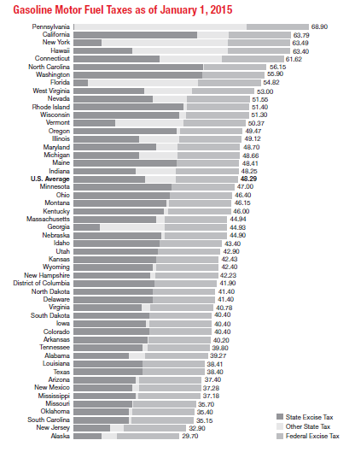
California Gasoline Market - Taxes
The amount of tax levied on a gallon of gasoline in California is usually higher than nearly every other state
As of January 1, 2015, California retail gasoline taxes accounted for 63.8 cents per gallon
The U.S. average was 48.3 cents per gallon so California’s retail gasoline tax burden was 15.0 cents per gallon higher than the U.S. average
Source: American Petroleum Institute
California Energy Commission

Slide 26
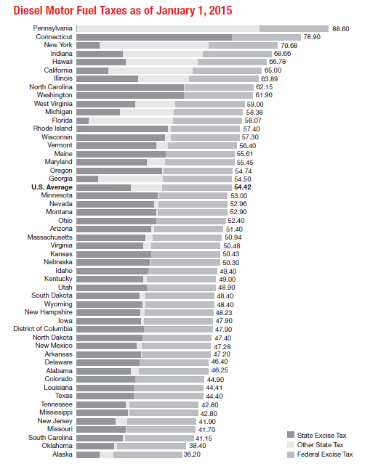
California Diesel Fuel Market - Taxes
The amount of tax levied on a gallon of diesel fuel in California is usually higher than nearly every other state
As of January 1, 2015, California retail diesel fuel taxes accounted for 65.0 cents per gallon
The U.S. average was 54.4 cents per gallon so California’s retail gasoline tax burden was 10.6 cents per gallon higher than the U.S. average
Source: American Petroleum Institute
California Energy Commission

Slide 27
Breakdown of Retail Gallon
Components of California Retail Gasoline:
  Refiner Margin - Refiner Margin (costs and profits) is calculated by subtracting the market price for crude oil from the wholesale price of gasoline. The result is a gross refining margin which includes the cost of operating the refinery as well as the profits for the refining company.
    Crude Oil Price: The daily market price of Alaska North Slope (ANS) crude oil is used as a proxy for the crude oil acquisition cost for California refineries.
    Refinery Costs and Profits: The costs associated with refining and terminal operations, crude oil processing, oxygenate additives, product shipment and storage, oil spill fees, depreciation, purchases of gasoline to cover refinery shortages, brand advertising, and profits.
California Energy Commission

Slide 28
Breakdown of Retail Gallon
Components of California Retail Gasoline:
  Distribution Margin - Distribution margin (distribution costs, marketing costs, and profits) is calculated by subtracting the branded wholesale gasoline price, taxes (state sales tax, state excise tax, federal excise tax, and a state underground storage tank fee), and environmental costs (fuels under the cap obligation) from the average retail sales price. The branded wholesale gasoline price is based on the average statewide branded refined "rack" price, information obtained from the Oil Price Information Service (OPIS).
    Wholesale Gasoline Price: The average wholesale gasoline price is the average of 13 branded wholesale prices at various wholesale fuel loading racks around the state. This average price is for a single day. The wholesale gasoline price is calculated for the same day as EIA's weekly average gasoline price.
      Branded Gasoline: Branded gasoline refers to fuel that is sold under a brand name (such as BP, Shell, Exxon, Chevron, and Valero). Branded gasoline will include proprietary fuel additives.
California Energy Commission

Slide 29
Breakdown of Retail Gallon
Components of California Retail Gasoline:
  State Underground Storage Tank Fee: The UST fee is currently 2.0 cents per gallon. Fee was 1.4 cents per gallon during 2014.
  State and Local Sales Tax: An average state sales tax rate of 2.25% percent is used in the calculation of the distribution margin although the actual sales tax rate does vary throughout California.
  State Excise Tax: The California state excise tax is currently 36.0 cents per gallon.
  Federal Excise Tax: The federal excise tax is currently 18.4 cents per gallon.
  Fuels-Under-the-Cap Obligation: The cost for fuel distributers for compliance with the AB 32 Cap & Trade obligations downstream of refineries. A daily calculation of the obligation is published by the Oil Price Information Service (OPIS). Calculated costs vary by the value of carbon credits and the carbon intensity of the transportation fuel (gasoline, diesel fuel, and propane).
California Energy Commission

Slide 30
Market Snapshots and
Factors Contributing to Price Increases
Dates:
  December 29, 2014 – Monday prior to the imposition of the fuels-under-the-cap obligation for California fuel distributers. Crude oil prices had already declined by over 50 percent from their peak in May of 2014. Supplies of gasoline were ample creating conditions for lower-than-normal refiner margins and higher-than-normal dealer margins. No significant refinery issues.
  February 17, 2015 – Tuesday prior to the explosion at the Exxon Mobil refinery in Torrance (Southern California) on the morning of February 18. Crude oil prices were virtually unchanged from late December. Supplies of gasoline had already tightened after the Tesoro Golden Eagle refinery in Martinez (Northern California) did not resume operations following planned maintenance due to a strike of refinery workers targeting that facility in early February. There were also a number of unplanned outages that also contributed to tighter supply conditions. As a consequence, refiner margins improved and dealer margins contracted. The FUTC obligation is now a component of the finished gasoline price.
California Energy Commission

Slide 31
Market Snapshots and
Factors Contributing to Price Increases
Dates:
  March 9, 2015 – Crude oil prices had eased a bit from mid-February. Supplies of gasoline have become scarcer with nearly 17.6 percent of the state’s refining capacity out of service (Tesoro Golden Eagle refinery still idled by striking workers and the Exxon Mobil refinery producing little to no gasoline following the explosion at that facility). Loss of refining capacity and declining inventory levels have placed a premium on wholesale gasoline prices resulting in higher-than-normal refiner margins and higher-than-normal dealer margins.
  March 23, 2015 – Retail prices continue to drop, down 17.2 cpg since March 9. Crude oil prices are nearly unchanged since March 9. Gasoline inventories continue to fall as the two refineries still are not back in operation. Loss of refining capacity and declining inventory levels keep a premium on wholesale gasoline prices resulting in higher-than-normal refiner margins, while dealer margins have returned to late December levels.
California Energy Commission

Slide 32
Fuels-Under-the-Cap (FUTC) Tracking
Fuels-Under-the-Cap regulation went into effect January 1, 2015
The Oil Price Information Service (OPIS) calculates a value for the FUTC obligation each business day, California Cap-at-the-Rack (CAR)
Assessment valuation uses price of carbon x carbon intensity of the transportation fuel
  Winter CARB reformulated gasoline with 10 percent ethanol
  Summer CARB reformulated gasoline with 10 percent ethanol
  CARB diesel fuel
Majority of fuel providers have elected to use the daily OPIS CAR calculation for inclusion in their bills of lading at the distribution terminal
  Either as a line item or embedded in the price
Some marketers are calculating their own FUTC assessment and including in the overall price of the fuel
California Energy Commission

Slide 33
Fuels-Under-the-Cap (FUTC) Tracking
Assuming a California Carbon Allowance price of $11.80/mt
CAR calculation for 1 gallon of winter CARB gasoline delivered at the rack would be:
  CAR = (((0.00891 x 0.9) x 11.80) + ((0.00022 x 0.1) x 11.80)) x 100
  CAR = 9.488cts/gal
CAR calculation for 1 gallon of summer CARB gasoline delivered at the rack would be:
  CAR = (((0.00893 x 0.9) x 11.80) + ((0.00022 x 0.1) x 11.80)) x 100
  CAR = 9.510cts/gal
CAR calculation for 1 gallon of CARB diesel delivered at the rack would be:
  CAR = (0.01024 x 11.80) x 100
  CAR = 12.083cts/gal
California Energy Commission

Slide 34
Fuels-Under-the-Cap (FUTC) Tracking
Energy Commission staff have been monitoring daily fuel prices
  Refinery wholesale or “spot” prices
    San Francisco, Los Angeles and Pacific Northwest
  Retail prices in several states
    California, Washington, Oregon, Nevada, Arizona, Texas, Illinois, Florida
When prices are declining due to a drop in crude oil it is more difficult to observe an impact of an FUTC assessment being passed through to retail
  One approach is to examine the difference in retail prices between California and other locations to see if a change has occurred and been sustained
  Also helpful to examine regional refinery markets for potential changes in scarcity or relative abundance of supply
California Energy Commission

Slide 35
Retail Fuel Price Tracking Observations
Gasoline
  The gap between California retail gasoline price and other Western states has increased between 31.8 and 43.7 cents per gallon from December 31, 2014 to March 19, 2015
  The calculated FUTC assessment by OPIS has averaged 10 cents per gallon over the same period and lies below the range of increased retail price differential
  Even greater differentials are attributed to increased tightness in the California gasoline market caused by refinery issues - crude oil prices remain at levels similar to the beginning of the year and thus not a contributing factor to this price spike
Diesel Fuel
  The gap between California retail diesel fuel price and other Western states has increased between 10.7 and 28.8 cents per gallon from December 31, 2014 to March 19, 2015
  The calculated FUTC assessment by OPIS has averaged 13 cents per gallon over the same period and lies within the range of increased retail price differential
California Energy Commission

Slide 36
California Energy Commission

Slide 37
California Energy Commission

Slide 38
West Coast Gasoline Inventories
California Energy Commission

Slide 39
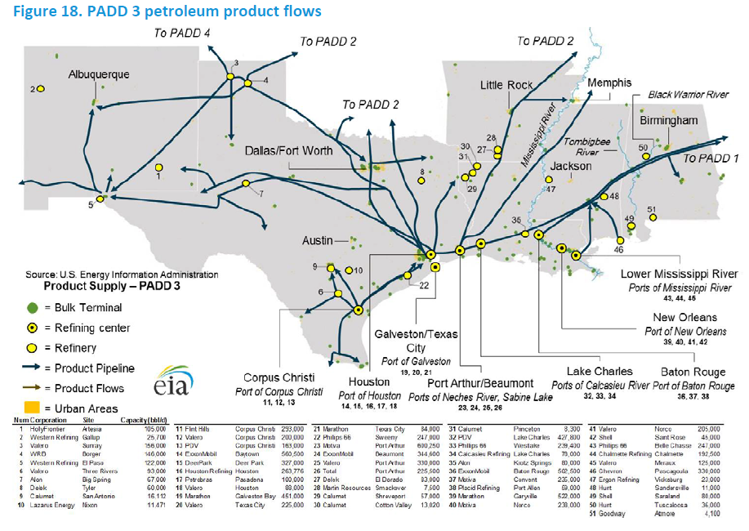
U.S. Gulf Coast is Large Exporter
California Energy Commission

Slide 40
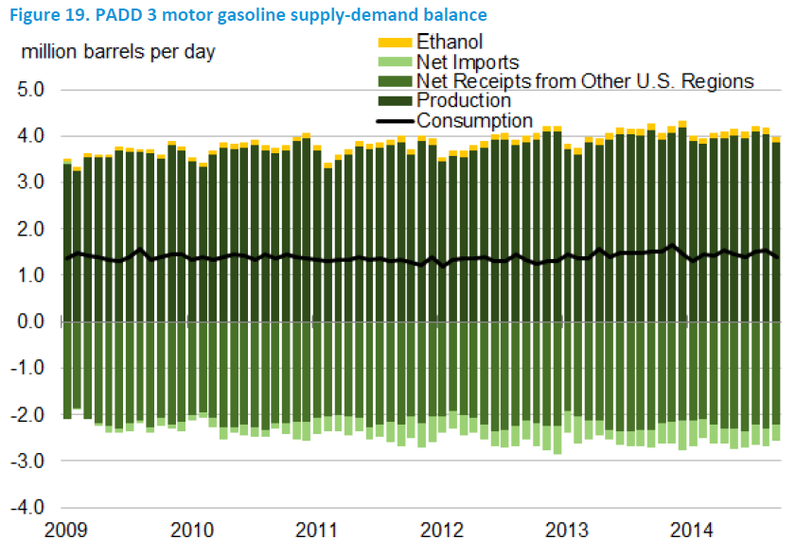
U.S. Gulf Coast Produces Excess Gasoline
California Energy Commission

