Slide 1
Presentation for Senate Subcommittee on Clean Reliability August 9, 2022 Alex Jackson, ACP-California Director Brian Biering, Attorneys for ACP-California
ACP – California represents the interests of utility-scale regional and offshore wind, solar and storage (“clean capacity”) in California and throughout the West. ACP-California advocates for clear and predictable rules for planning new clean capacity as well as market rules that encourage collaboration with energy-partners throughout the West.

Slide 2
Reliability Standards Are a Condition Precedent to Clean Energy Goals
Proactive procurement and transmission planning and address delays in transmission development
Timely and predictable procurement signals for a “broad and diverse” mix of resources
We need to know when procurement will happen, what is being procured and be able to anticipate procurement directives. Uncertainty leads to costly, last-minute procurement.
Development cycles are multi-year endeavors. It takes time to identify a site, execute a power contract, get financing, develop the site, complete interconnection
Certainty in the IRP and RA programs, particularly in terms of counting conventions and program rules is critical to developing new projects.
Clear predictable procurement structures will help facilitate financing and transmission/ generation resource development

Slide 3
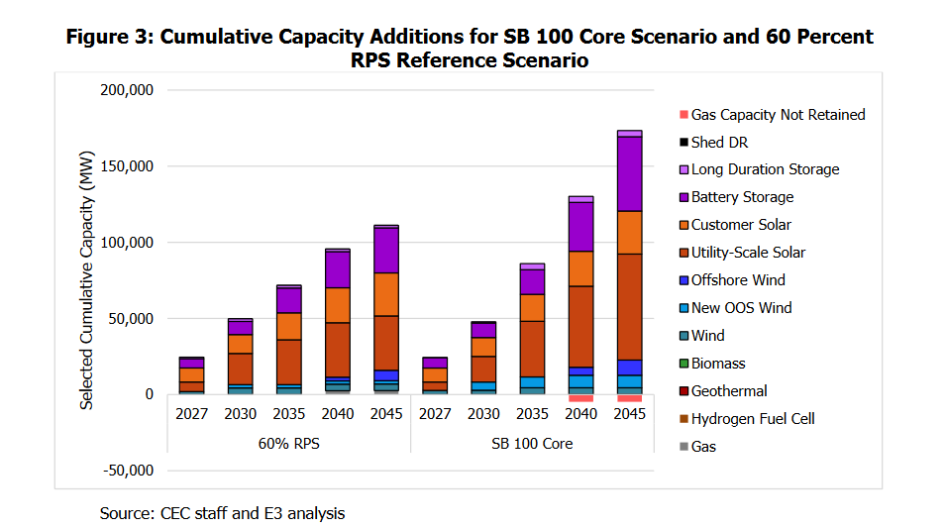
Source: SB 100 Joint Agency Report: Charting a Path to a 100% Clean Energy Future

Slide 4
Proactive Transmission Development and Regional Coordination Will Further Clean Reliability
Transmission is critical to reliability. Transmission which provides deliverability which is a core requirement for any RA contract. Transmission itself is also a reliability solution by reducing congestion in local reliability areas.
State needs a clear picture of how much deliverability is needed across the entire transmission system both in the near term and the longer term. There is little action on long-term transmission need. We need to ensure that the CAISO is empowered to plan for transmission 20 years in the future.
Our planning processes are slow and are often relying on outdated information. There is roughly a three year lag between the IRP and TPP processes. For example, the 2022 IRPs filed by LSEs in November will be consolidated in a 2023 IRP PSP decision, The 2023 IRP PSP decision will presumably feed into the 2024-2025 TPP. A 2025 TPP approving projects based on 2022 LSE data is out of date.
We need coordinated and proactive transmission development that focuses on ensuring that the entities responsible for transmission development are prioritizing and unlocking the greatest amount of deliverability on the system.

Slide 5
Coordination with the Broader West will further California’s Affordability and Reliability NREL: Annual Average Wind Speed Map (100 M hub height)
Source: https://www.nrel.gov/gis/assets/images/wtk-100-north-america-50-nm-01.jpg

