Slide 1
Prospects for School/Public Agency Solar Clean Energy High Value Jobs
Dr. Rick Brown | Chair of the Board, TerraVerde Energy

Slide 2
Background
Rick’s Background
1982-2005: Organizational consultant with public agencies and non-profits: California School Employees Association, CalPERS, Kaiser-Permanente, BART, EarthJustice
1992-1999: President/ School Board Member, Twin Hills Unified School District
2005-2009: Co-Founder MMA Renewable Ventures
2009-Present: Founder/CEO/Boar Chair TerraVerde Energy
About TerraVerde Energy
Since 2009, has helped 350 schools, 100 other public facilities implement solar (more recently battery storage)
Reduced millions of tons reduced GHGs, $60 million energy savings, over 1000 prevailing wage jobs.
Notes:
Header Font: Avenir Medium, 30 pt., Bold, All Caps
Body Font: Avenir Light, 20pt, Line Spacing Multiple at 1.2

Slide 3
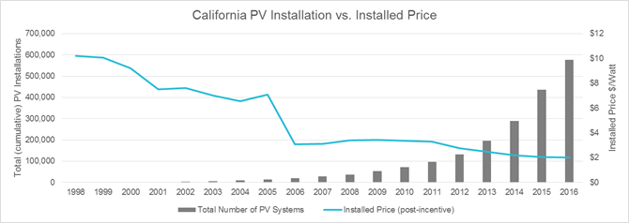
Solar Clean Energy Job Growth Policy Drivers 2006-2022
1996: California Net Metering Policies
2006: Federal Energy Policy Act: Original Investment Tax Credit Legislation
2007: California Solar Initiative (“CSI”)
2012 Balanced Budget: Lower risk premium/cost of capital for solar
2012: Prop 39: California Clean Energy Jobs Act
2022: Inflation Reduction Act
Notes:
Header Font: Avenir Medium, 30 pt., Bold, All Caps
Body Font: Avenir Light, 20pt, Line Spacing Multiple at 1.2

Slide 4
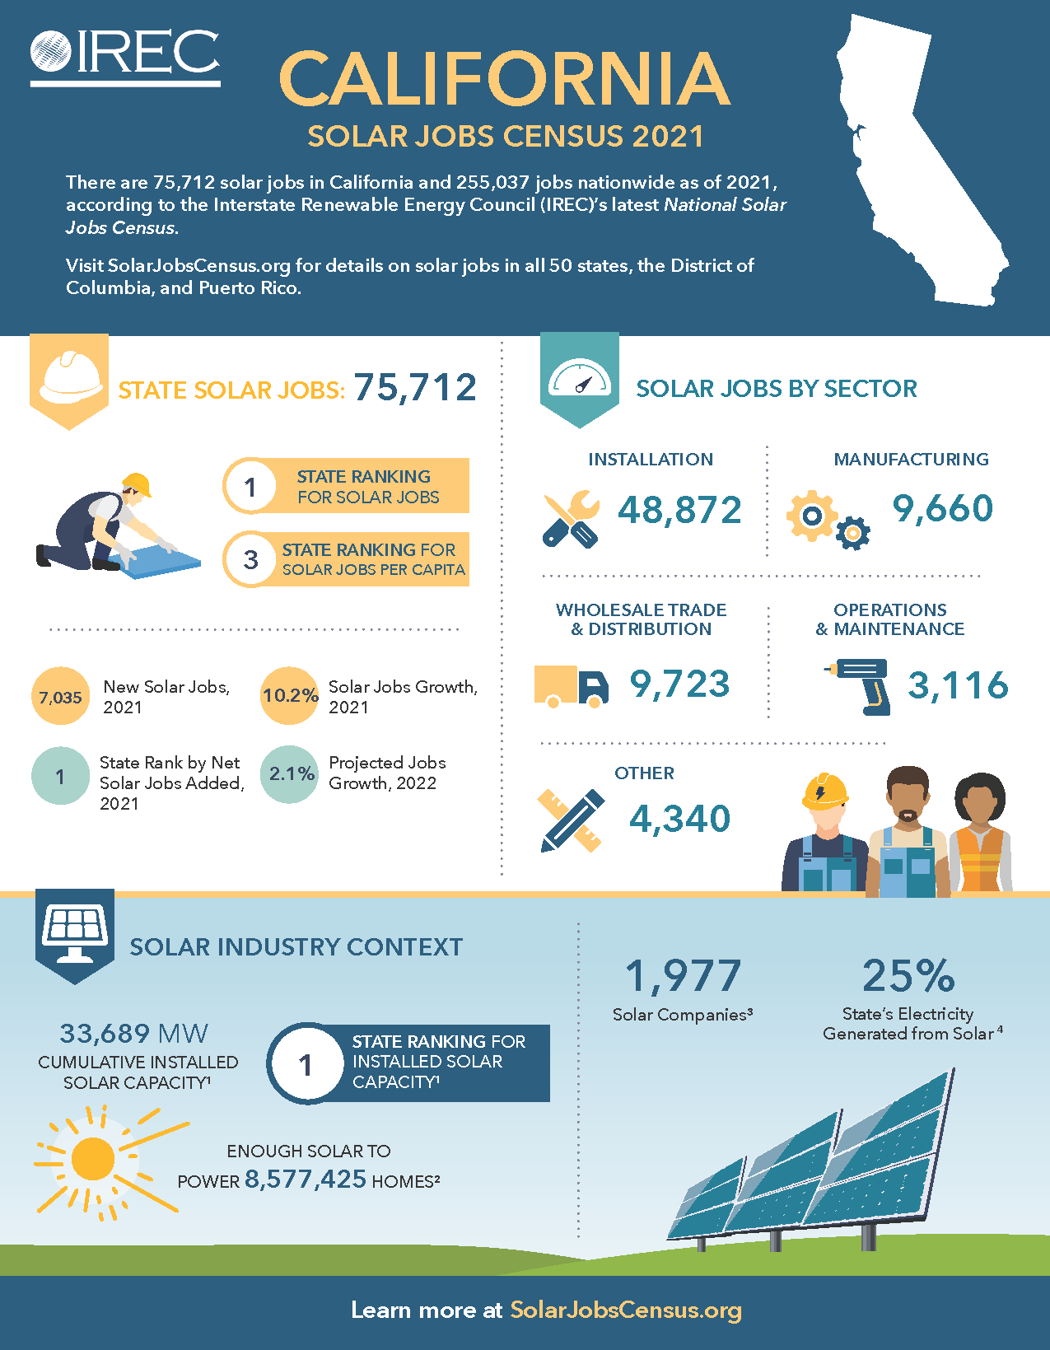
Solar Clean Energy Jobs Today
2800+ schools in California now having solar and a small but growing number have battery storage
Recent passage of the Bipartisan Infrastructure Bill and Inflation Reduction Act
Obstacles to growth of school and other public facility solar jobs in California
CPUC Net Metering/Net Billing Proposed Decision
Hits/hurts school’s unique energy use/load profile
Supply chain
Increasing risk premium/cost of capital
Notes:
Header Font: Avenir Medium, 30 pt., Bold, All Caps
Body Font: Avenir Light, 20pt, Line Spacing Multiple at 1.2

Slide 5
The Future of Solar Clean Energy Jobs
Impact of new CPUC Net Metering/Net Billing Proposal on School/Public agency solar project financials
Examples
School District: 4 solar projects and 1 solar + battery project deployed under a power purchase agreement in PG&E’s service territory
The School District is saved $45,162 in year 1 under NEM 2.0
The School District would have lost $57,009 in year 1 under the proposed Net Billing Tariff
Water Agency: a solar project under development at a water reclamation facility
The Water Agency is projected to save $191,794 in year 1 under NEM 2.0
The Water Agency would lose $84,012 in year 1 under the proposed Net Billing Tariff
Schools and other public agencies do not implement projects that increase their costs
The result…clean energy job losses
Potential areas of growth
Batteries for grid back-up
Operations and Maintenance
Notes:
Header Font: Avenir Medium, 30 pt., Bold, All Caps
Body Font: Avenir Light, 20pt, Line Spacing Multiple at 1.2

Slide 6
Dr. Rick Brown | Chair of the Board
rick@terraverde.energy
Notes:
Statement Font: Avenir Light, 30pt, Italicized, Line Spacing Multiple at 1.5

