Slide 1




Senate Energy, Utilities and Communications Committee
Partnering with California's Schools:
The IOU Energy Efficiency Programs
Gene Rodrigues, Southern California Edison
Gillian Wright, Southern California Gas & San Diego Gas & Electric
Janice Berman, Pacific Gas and Electric
February 19, 2013

Slide 2
IOUs and California’s Schools: Three Decades of Working Together on Energy Efficiency
Serve most of California’s 11,000 K-12 schools through management of 30,000 K-12 school accounts
Provide energy and EE offerings to classrooms, administrative offices, central kitchens, food service facilities, cafeterias, and athletic facilities
Over last five years IOUs have:
  Worked directly with 9,000 school accounts to implement EE measures
  Performed nearly 5,000 audits, benchmarked 2,500 schools
  Helped facilitate investment of over $115 million in EE upgrades by providing $62 million in rebates and incentives
  Coordinating with schools, saved 280,000 MWh, 51 MW, 4.3 million therms, 220,000 metric tons CO₂
    As much energy as consumed in about 40,000 California homes annually

Slide 3
IOUs Offer K-12 Schools a Comprehensive Array to Deliver Energy Savings
IOUs offer a range of assistance to California’s public and private K-12 schools through multiple delivery channels and public and private partnerships to help schools reduce their energy usage
These include “traditional” EE measures and technologies, as well as a comprehensive array of related energy assistance, all tailored to the needs of the schools
EE Measures and Technologies
Energy Audits
Benchmarking of energy performance
Rebates and incentives for installing Energy Efficient:
  Lighting (indoor, athletic, security, other)
  Heating, Ventilation and Air Conditioning (HVAC)
  Energy Controls and Management Systems
  Food Service Technology (vent hoods, refrigeration, other)
  Window and Window films
  New Construction Rebates
Zero-interest loans and On-Bill Financing
Partnerships with School Districts, and with local governments, publicly owned utilities, others
EE and Clean energy curriculum support and teacher training
Retro-commissioning and Continuous Energy Improvement to ensure efficient ongoing performance
Additional EE and Clean Energy Assistance
Demand Response incentives and technical support
Emerging Technology support
Workforce Training and Outreach
Solar power and hot water incentives

Slide 4
IOUs Design and Implement EE Initiatives to Meet the Unique Needs of K-12 School Facilities
IOUs
3rd Party
Implementers
Customers’ Contractors
Customer Education & Assessment
Site visit
Audit/data collection
Calculation of savings & ROI
Provide recommen-dations
Installation of most beneficial equipment
Benchmarking
Quality Assurance and EM&V
4

Slide 5
One Size Does Not Fit All
  EE needs in California’s schools vary considerably. IOUs work with a broad range of schools to deliver solutions that fit.
School projects vary considerably in size
  From small $20,000 single measure projects to $950,000 comprehensive projects
Appropriate EE measures vary
  Measures may include some or all of: audits, benchmarking, highly efficient lighting, advanced controls and energy management systems, chillers/air conditioning, pools, and others
Appropriate energy savings solutions vary
  In addition to incentives for specific EE technologies, many schools benefit from zero interest on-bill financing, technical assistance, solar and demand response incentives, and clean energy curricular materials
EE services are delivered through a variety of channels
  IOUs and schools work with many partners including: third party implementers, construction firms, ESCOs, state and local government agencies, and others
Single School Single measure / Single site | Urban School Multi-measure/Single Site | Rural School District Large Multi-site/Multi-Measure
$21,000 Loan to implement a $25,000 Project Pools Retrofit – New Variable Flow Pumps 207,000 kWh and 9,000 Therms saved annually | $360,000 Loan to implement a $380,000 Project HVAC Retrofit, Lighting Controls and Pool Heating/Pumps, Lighting Retrofit 41,000 kWh saved annually | $900,000 Loan to implement a $944,000 project Multiple schools Lighting and HVAC retrofit and Controls 560,000 kWh saved annually

Slide 6
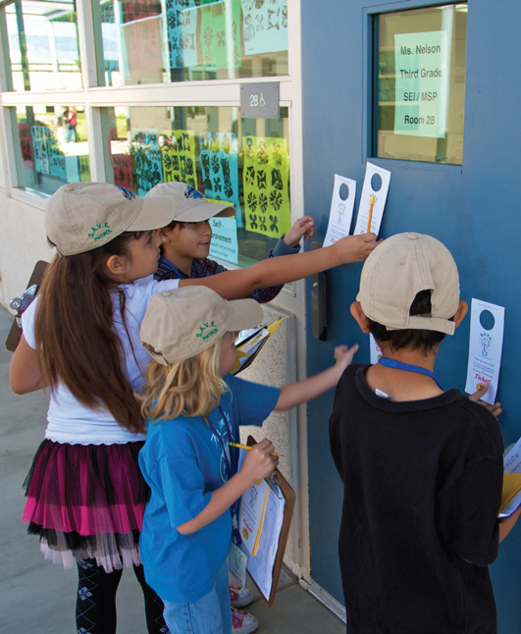
SDG&E Case Study: Escondido Unified School District (EUSD)
“The district was able to save $230,000 off its bill and reallocate those dollars back into the general fund to support the educational goals of the district.” - Gina Manusov, Assistant Superintendent, Business Services for EUSD
“The extra benefits are that the quality of lighting in the classrooms and workspaces is better.” – Ass’t Sup’t Manusov
Improvements:
  Lighting retrofits
  Desktop management software that puts PCs to sleep when
  not in use
Financial Assistance: Rebates and On-Bill Financing
S.A.V.E. Patrol: Students tasked with making sure lights are off, doors are closed, and unnecessary equipment is not left running
Energy Savings: 1,895,093 kWh
EUSD saved significant energy by installing software that puts PCs in sleep mode like these in the computer lab at Farr Elementary.

Slide 7
SCE’s “No Cost” Program for Schools
Case Study: South LA Area School District
  Full turnkey solution offered including site assessment, installation, and measure verification
Improvements:
  Interior lighting retrofits
  Occupancy Sensors
  Vending Machine Misers
Project Cost /Customer Value = $638,740
Energy Savings: 1,410,000 kWh
Demand Reduction: 585 kW
Annual Savings: $195,000
Project Background:
  Economically challenged district
  Lack of Energy Manager, technical expertise
  and project management resources

Slide 8
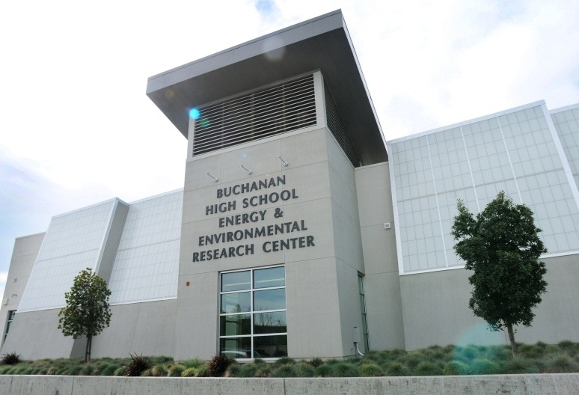
PG&E Case Study: Clovis Unified School District (CUSD) – A Comprehensive Approach
“We managed to keep our energy bills the same for the last five years… in spite of increasing our square footage by…800,000 sq. ft.” – Don Ulrich, Asst. Superintendent, CUSD
Improvements (2008-2013):
  HVAC controls and tune-ups
  Lighting, motors, water heaters, PC power management
  Chillers, boilers, controls, pool heaters, pool covers
  New construction design assistance
Energy Savings: 3,060,175 kWh
195,722 Therms
Demand Reduction: 1,094 kW
Incentives: $686,380
Additional Initiatives:
  Demand Response: Peak day pricing
  Solar: Planning a $23 million solar project to generate power for 21 of their 43 school sites

Slide 9
K-12 Schools: Opportunity for the Future
Past experience provides insight: the path forward to increase energy savings in K-12 schools
Comprehensive, deeper EE retrofits are achievable if upfront project funding is available
Resident Energy Managers are needed at the district level to provide technical assistance and expertise to oversee EE projects
Scaled-up financing could spur investment in EE projects by offering access to capital prior to construction
Specialized technical assistance would help to analyze EE opportunities, provide direction on implementation, and explore funding options
Upgrades to aging infrastructure are needed at some K-12 school facilities to allow for EE retrofits
Operations, maintenance and energy management training are essential to sustain energy savings and equipment performance

Slide 10
THANK YOU
QUESTIONS?

